Slide 1

Web-Based Application for Ordering Tables and Dishes of Cafe Tepi Danau Bistro
Institut
Teknologi
Del
GROUP 09:
11321023 Emy Sonia Sinambela
11321032 Bennedict Tambunan
11321034 Akdes Simon Simamora
11321039 Putra Jaya Manurung

Slide 2
Outlines
1. Introduction
2. Contents
• Purpose of Document
• Current System (BPMN) Condition
• Target System (BPMN) Conditions
• Main functions in the Web App
• Functional Description : Use case Diagram -> Use case Scenario
• ERD model
• Functional and Non-functional requirements
• CDM model
• PDM model
• Class Diagram
• Sequence Diagrams
• Package Diagram
• Test Script & Result
3. Conclusion
4. Demo Product

Slide 3
Introduction
Topic
Web-Based Application for Ordering Tables and Dishes of Cafe Tepi Danau Bistro
Background
The difficulty of information regarding the menu of dishes available at Cafe Tepi Danau Bistro
Ordering via WhatsApp results in a buildup of messages so that it takes a long time
Objective
Make it easier for owners to provide information on the menu of dishes available at Cafe Tepi Danau Bistro
Make it easier for customers to place orders so that it doesn't take a long time

Slide 4
Purpose Of Document
This document was written as a summary of the design of the construction of the Web-Based Application for Ordering Tables and Dishes of Cafe Tepi Danau Bistro. The purpose of writing the document is as follows :
1. Describe the functions contained in the Web-Based Application for Ordering Tables and Dishes of Cafe Tepi Danau Bistro.
2. Describe the development and operating environment of the Web-Based Application for Ordering Tables and Dishes of Cafe Tepi Danau Bistro.
3. Describe the table used in the Web-Based Application for Ordering Tables and Dishes of Cafe Tepi Danau Bistro attached with entity relationship diagrams, class diagrams, conceptual data models, physical data models .
4. Explain the testing carried out on the Web-Based Application for Ordering Tables and Dishes of Cafe Tepi Danau Bistro so that a conclusion is reached whether the application is suitable for use or not.

Slide 5
Current System
At this time, the process of ordering tables and dishes of Cafe Tepi Danau Bistro is still running manually which is divided into 2 ways, that is, customers come to Cafe Tepi Danau Bistro to order tables and dishes according to their needs. The second way is, customers contact the Cafe Tepi Danau Bistro via WhatsApp to place a table reservation in advance. The ordering process that runs manually is less efficient because customers don’t know the crowds in the cafe, so it is not uncommon for customers not to get a dining table because of the long queue. The ticket booking process carried out via WhatsApp can also take a lot of time because it is possible that the message sent from the customer to the café is hoarded by other messages and cannot handle the entire message quickly. In addition, many of the customers do not fully know information such as addresses and menus available at Cafe Tepi Danau Bistro so they need a web app that presents information to place an order at Cafe Tepi Danau Bistro.

Slide 6
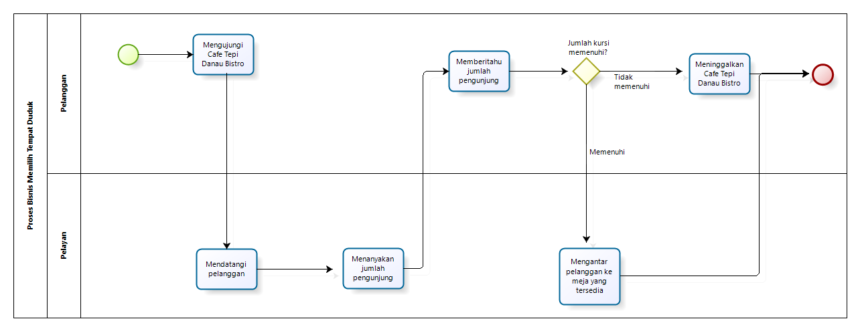
Current System
1. BPMN Chooses Table Directly

Slide 7
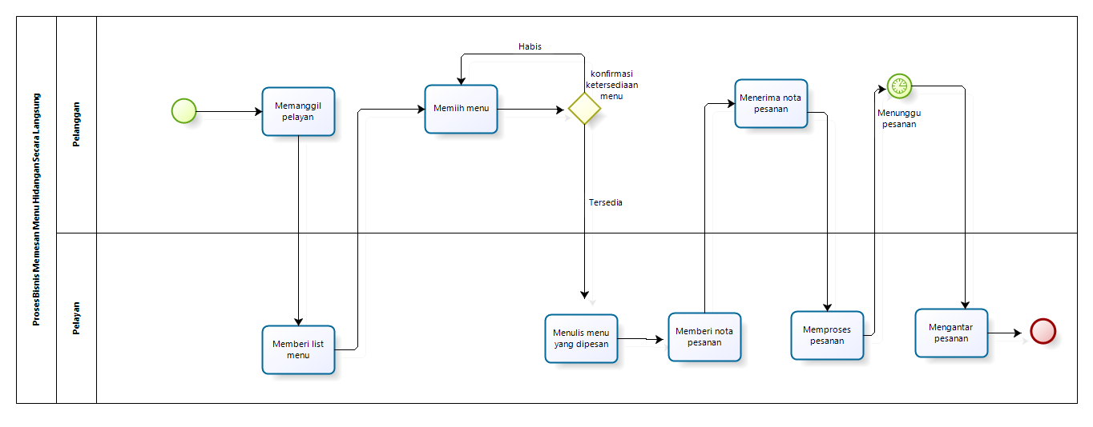
Current System
2. BPMN Orders Menu Directly

Slide 8
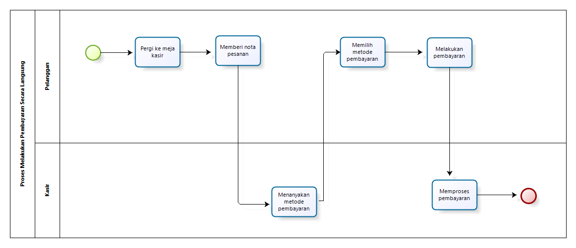
Current System
3. BPMN Makes Payments Directly

Slide 9
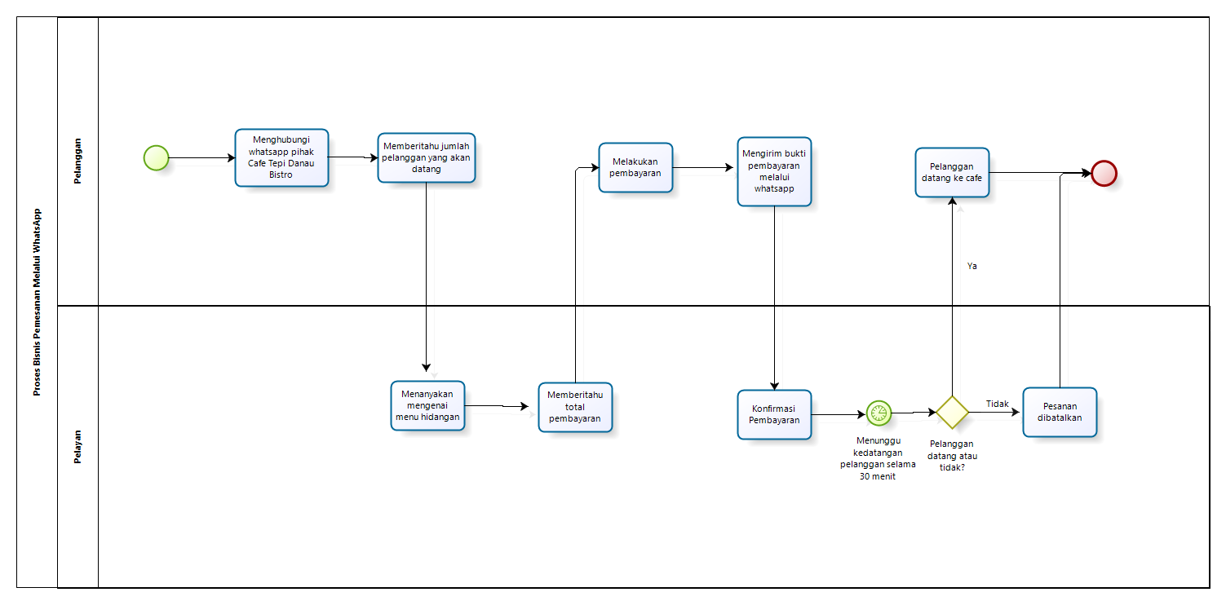
Current System
4. BPMN Ordering Via WhatsApp

Slide 10
Target System
Web-Based Application for Ordering Tables and Dishes of Cafe Tepi Danau Bistro was created to make it easier for customers to get information about the Cafe Tepi Danau Bistro. The system developed by the developer was created to minimize the problems that exist today, namely to reduce the possibility of customers not getting tables due to crowds in the café and avoid the possibility of messages being buried between customers and waiters on duty. This system is also expected to help customers in seeing information on food menus available through the system and make it easier for customers to order tables and dishes. To be able to place an order in this system, customers must first register an account. After the customer's account has been registered, the account can log in to the existing system.

Slide 11
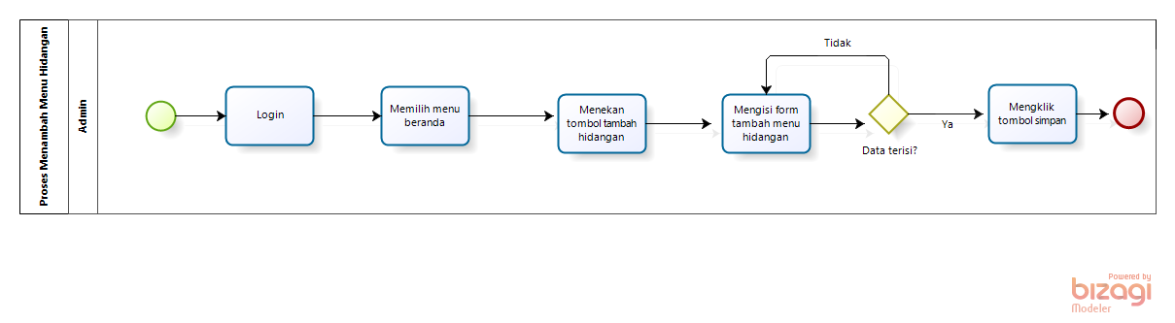
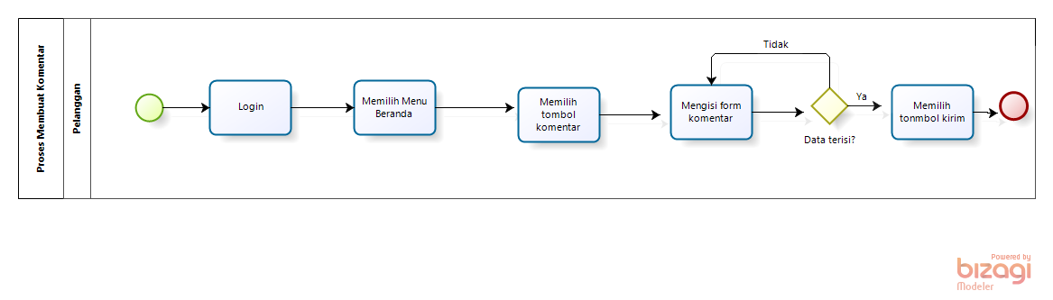
Target System
BPMN Adds to the Menu of Dishes
BPMN Make a comment

Slide 12
Functions in the web app
The main function of Web-Based Application for Ordering Tables and Dishes of Cafe Tepi Danau Bistro :
Function for registration 11. Function for providing testimonials
Function for login 12. Function view about cafe
Function add the menu of dishes 13. Function view the menu of dishes
Function update the menu of dishes 14. Function table and dish reservations
Function delete the menu of dishes 15. Function for make a payment
Function update of orders 16. Function for payment confirmation
Function delete of orders 17. Function delete a user
Function view order list 18. Function update capacity per table
Function view testimonial list 19. Function search for a menu of dishes
Function view user data 20. Function for logout

Slide 13
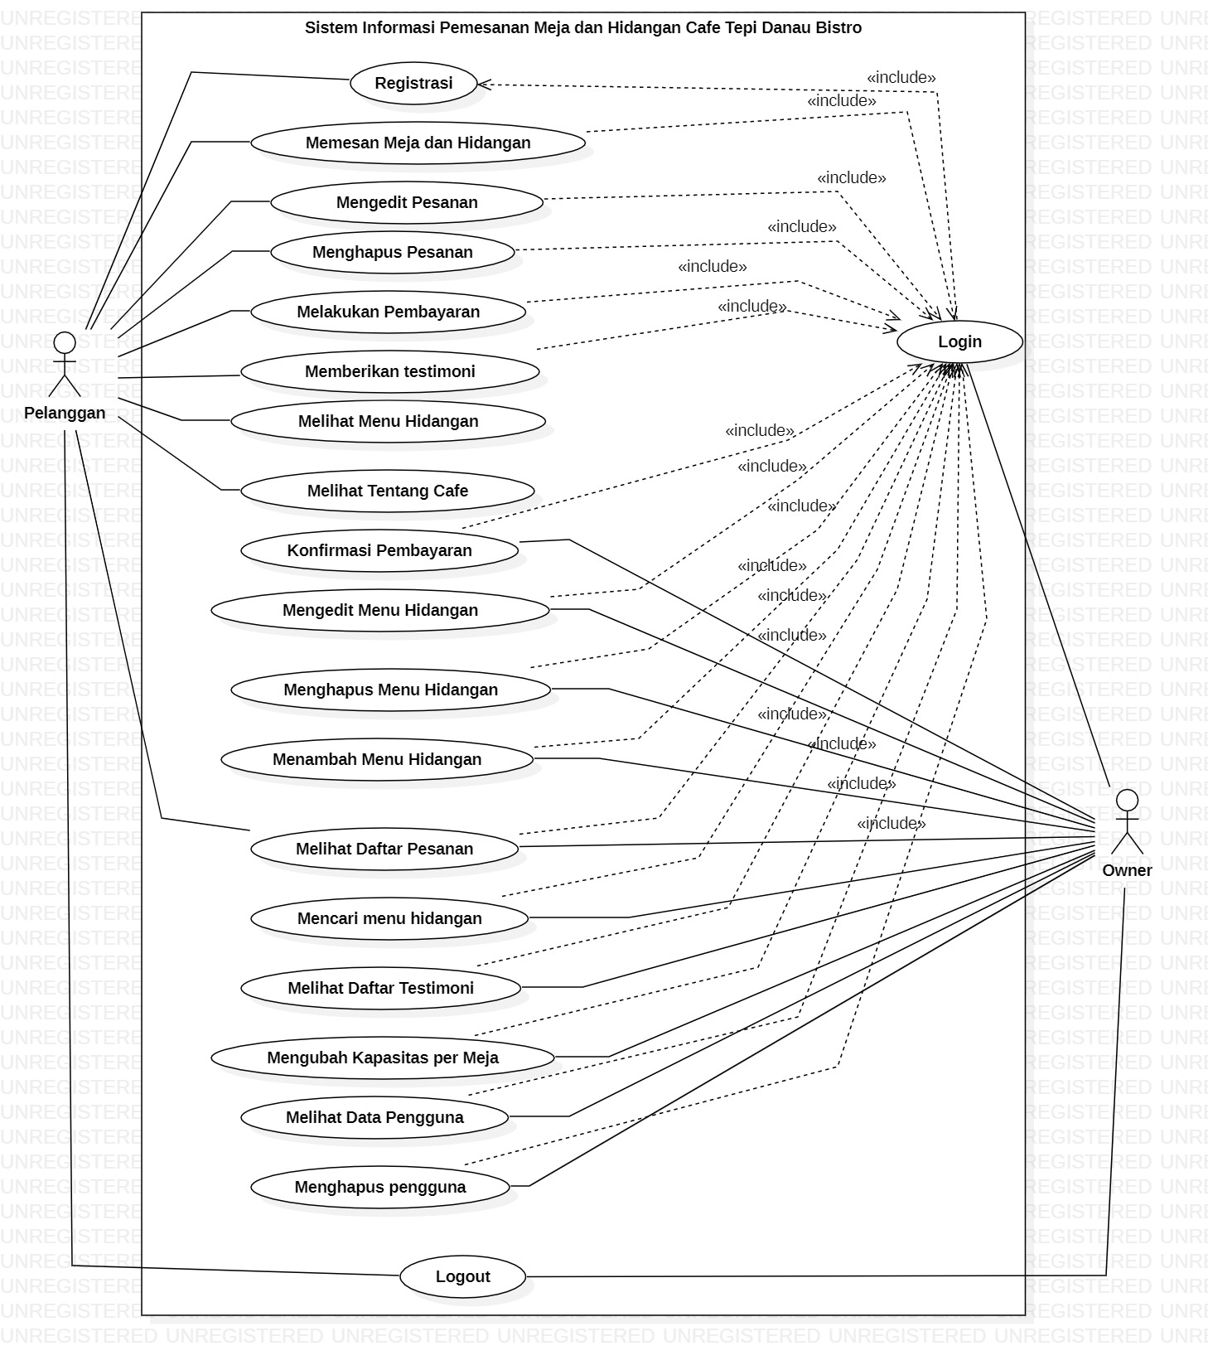
Use Case Diagram

Slide 14
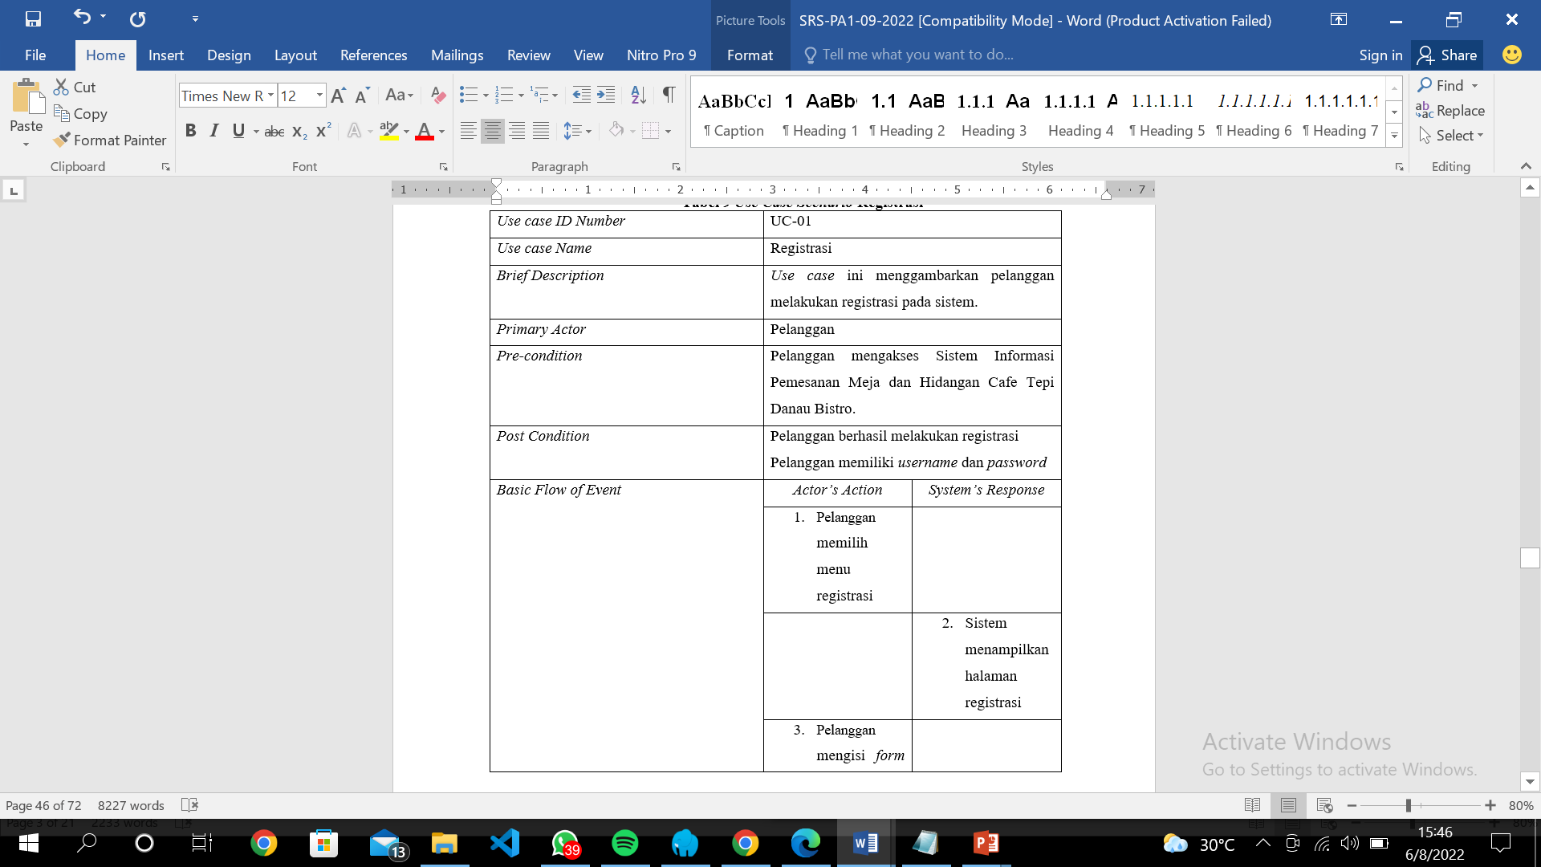
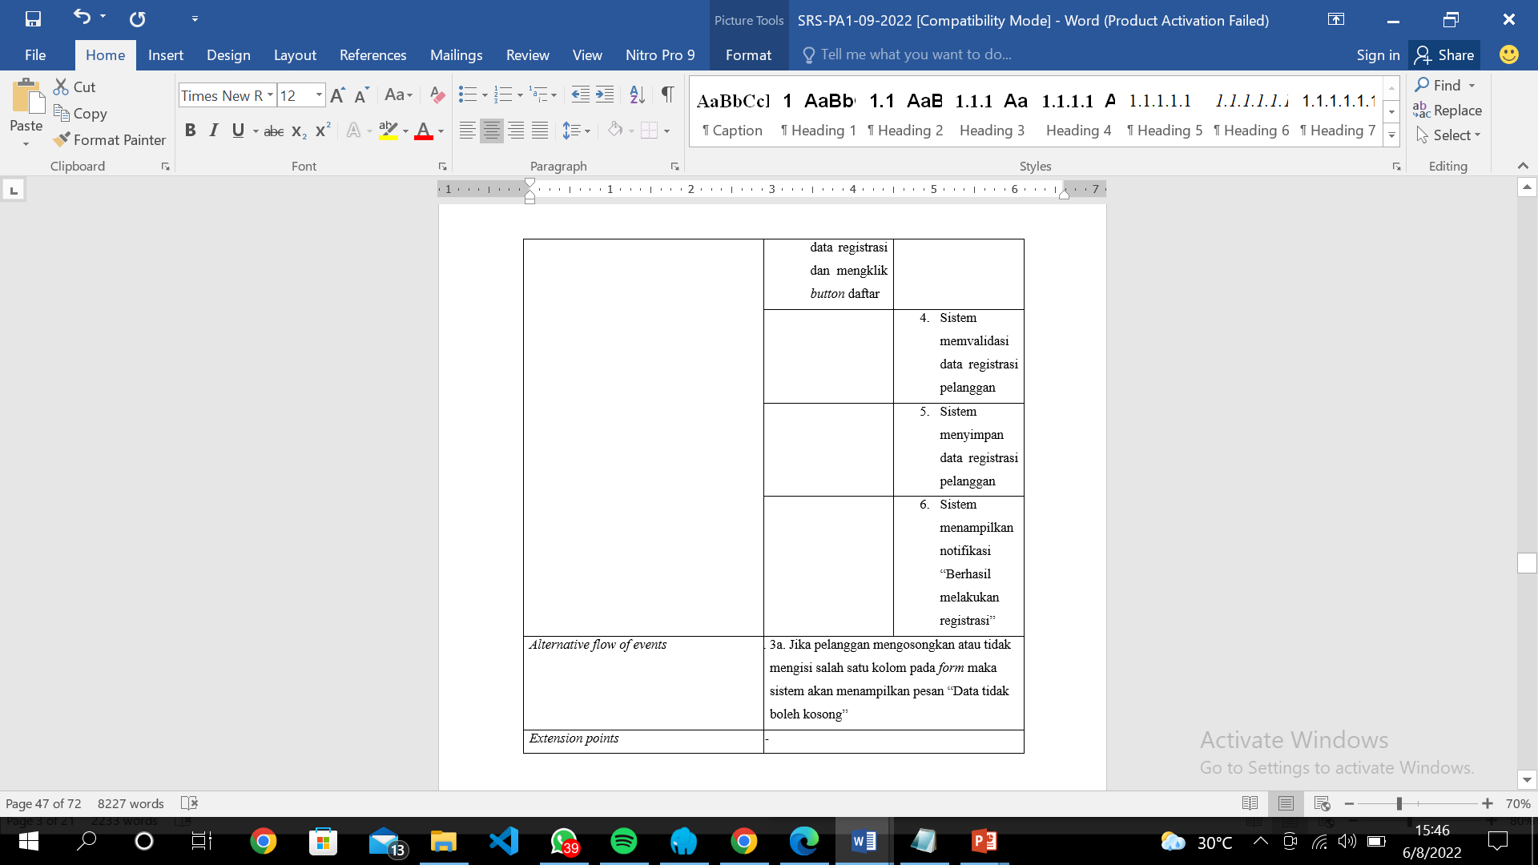
Use Case Scenario
Use Case Scenario Registration

Slide 15
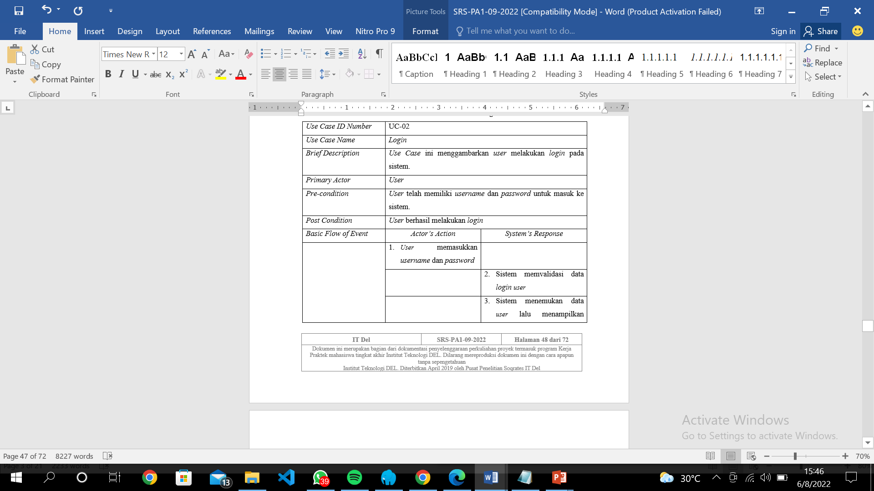
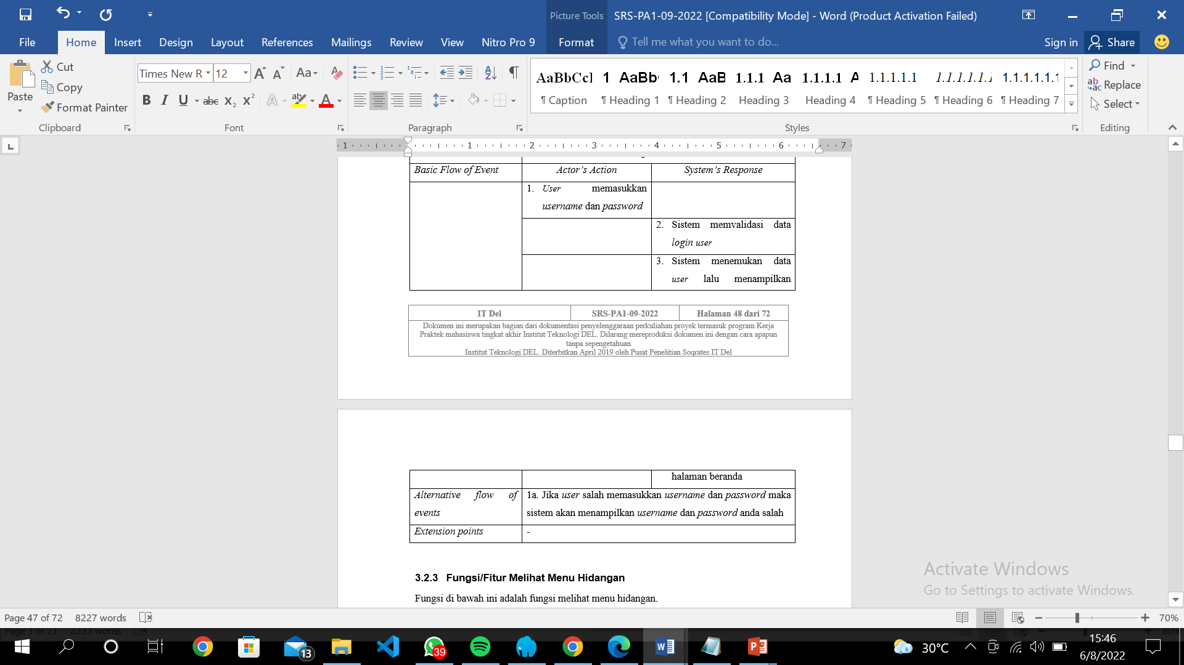
Use Case Scenario
Use Case Scenario Login

Slide 16
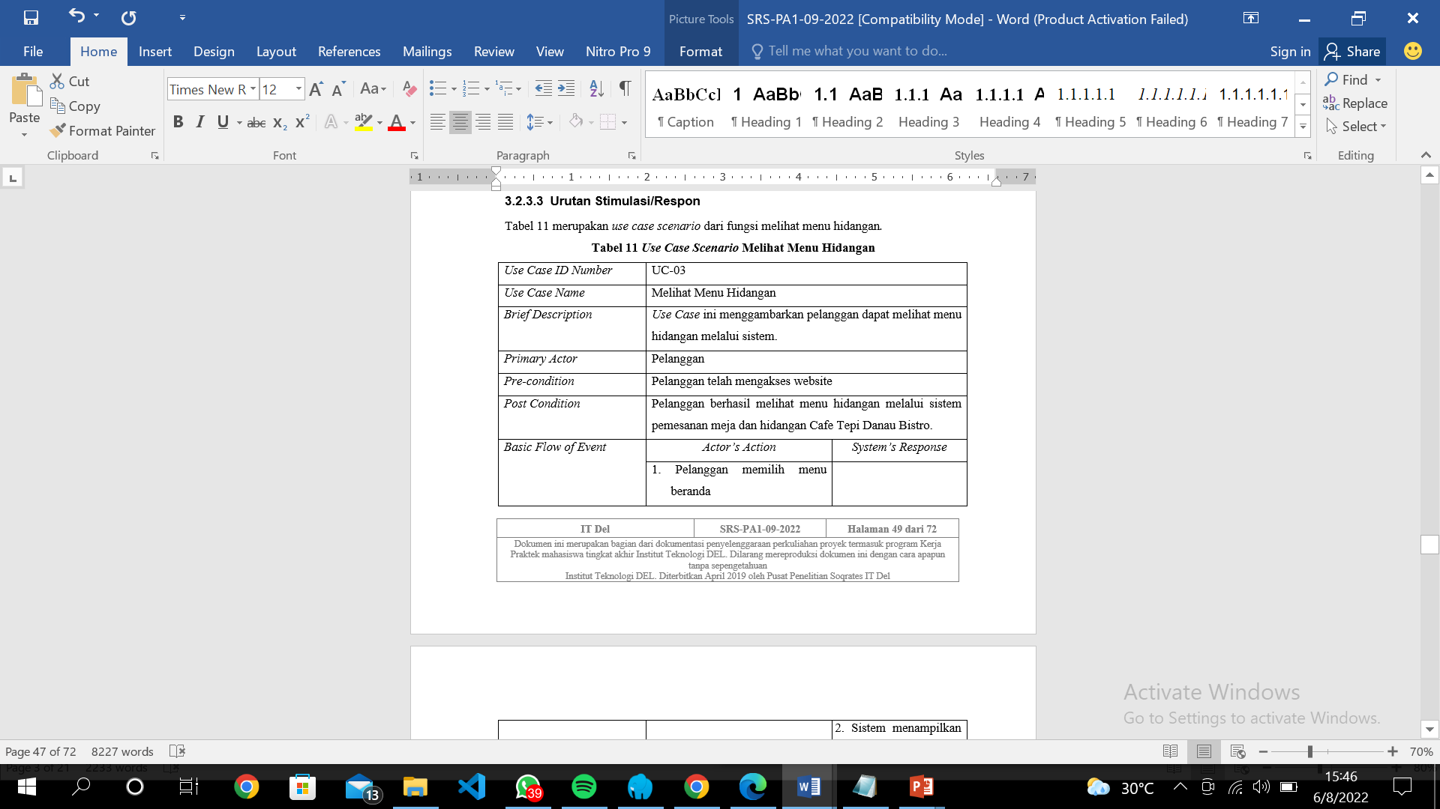
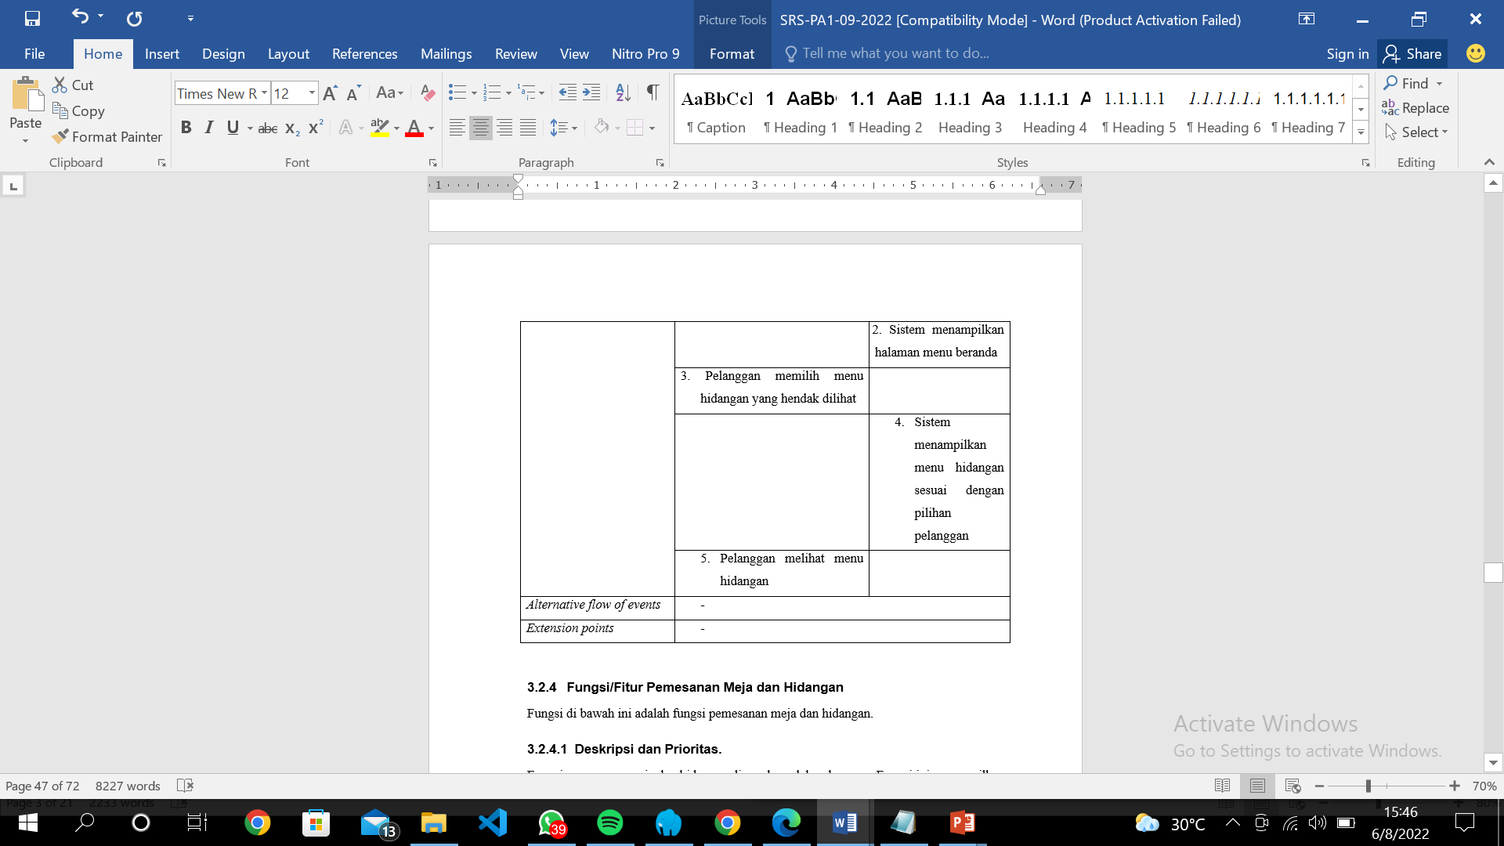
Use Case Scenario
Use Case Scenario View the Menu of Dishes

Slide 17
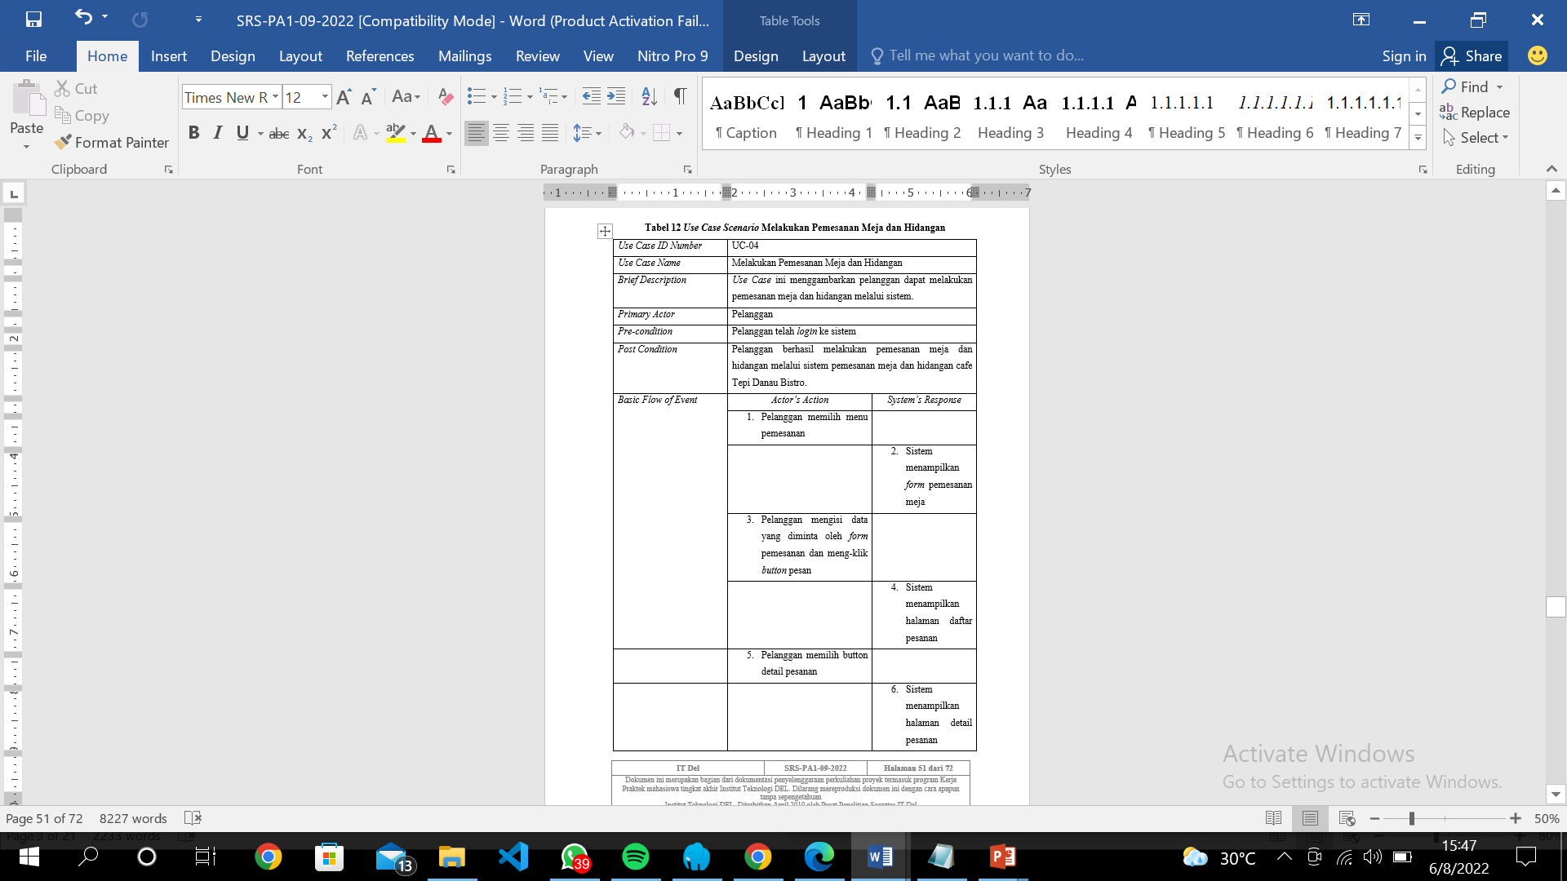
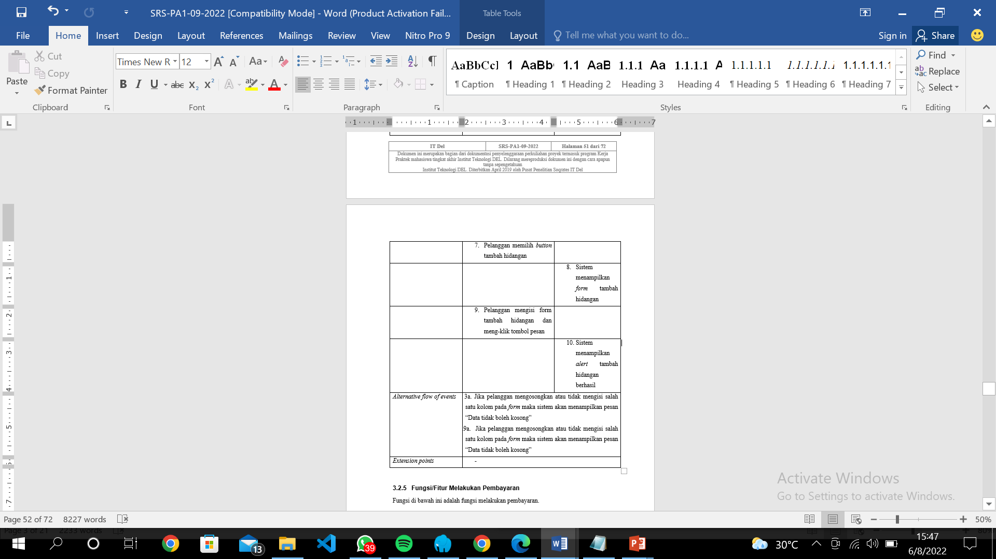
Use Case Scenario
Use Case Scenario Table and Dish Reservations

Slide 18
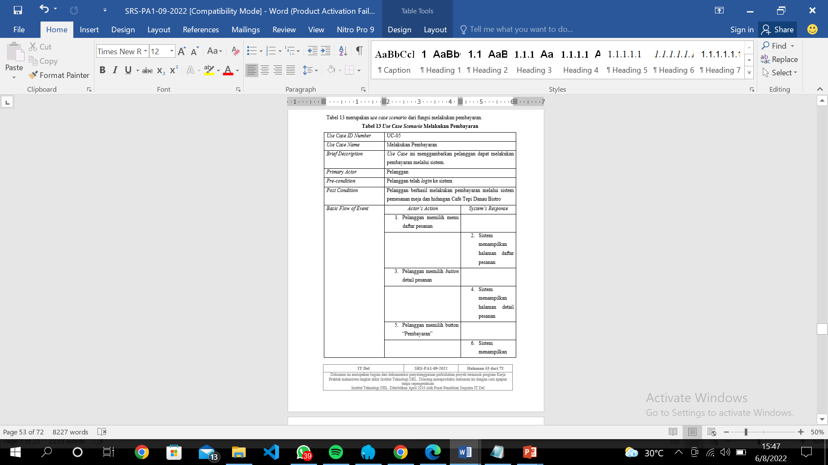
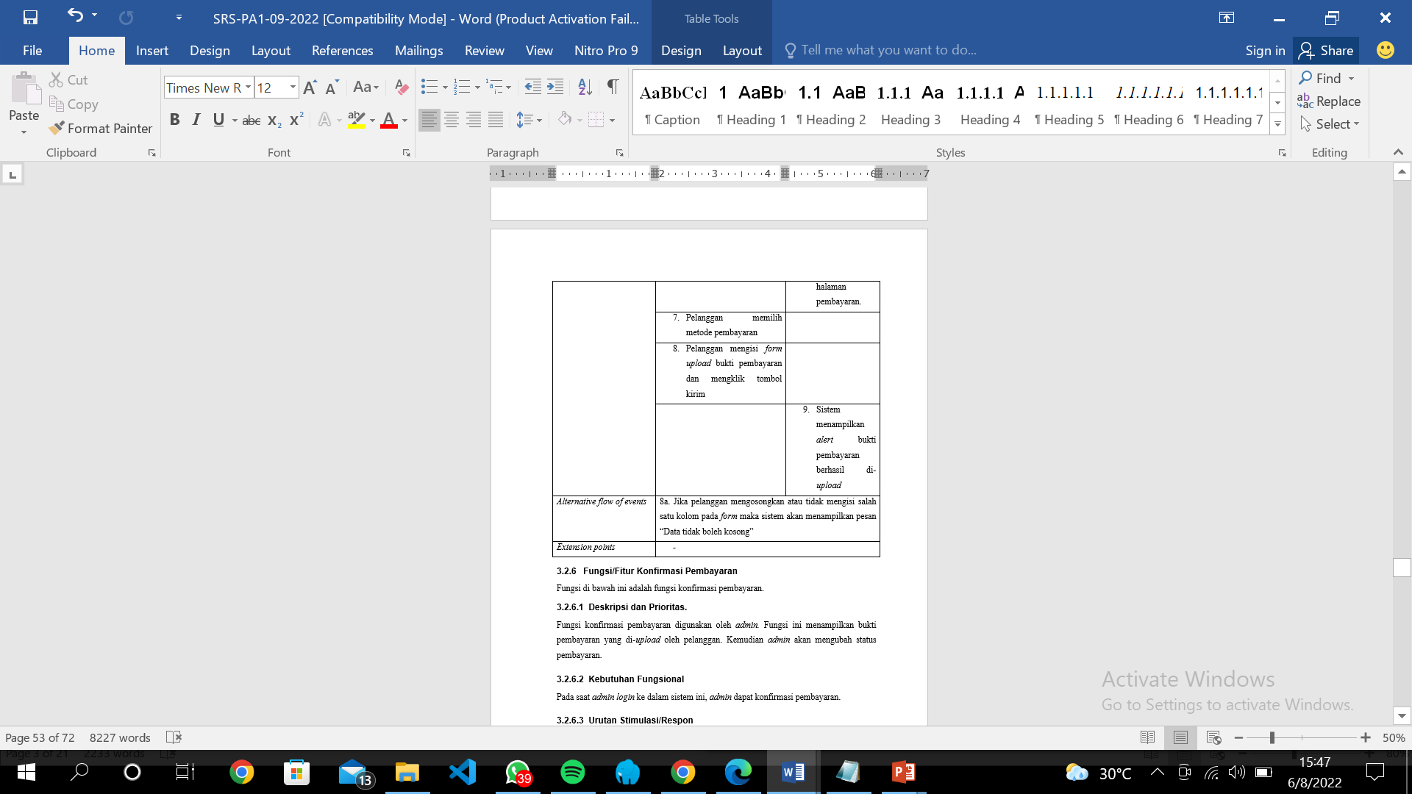
Use Case Scenario
Use Case Scenario For Make a Payment

Slide 19
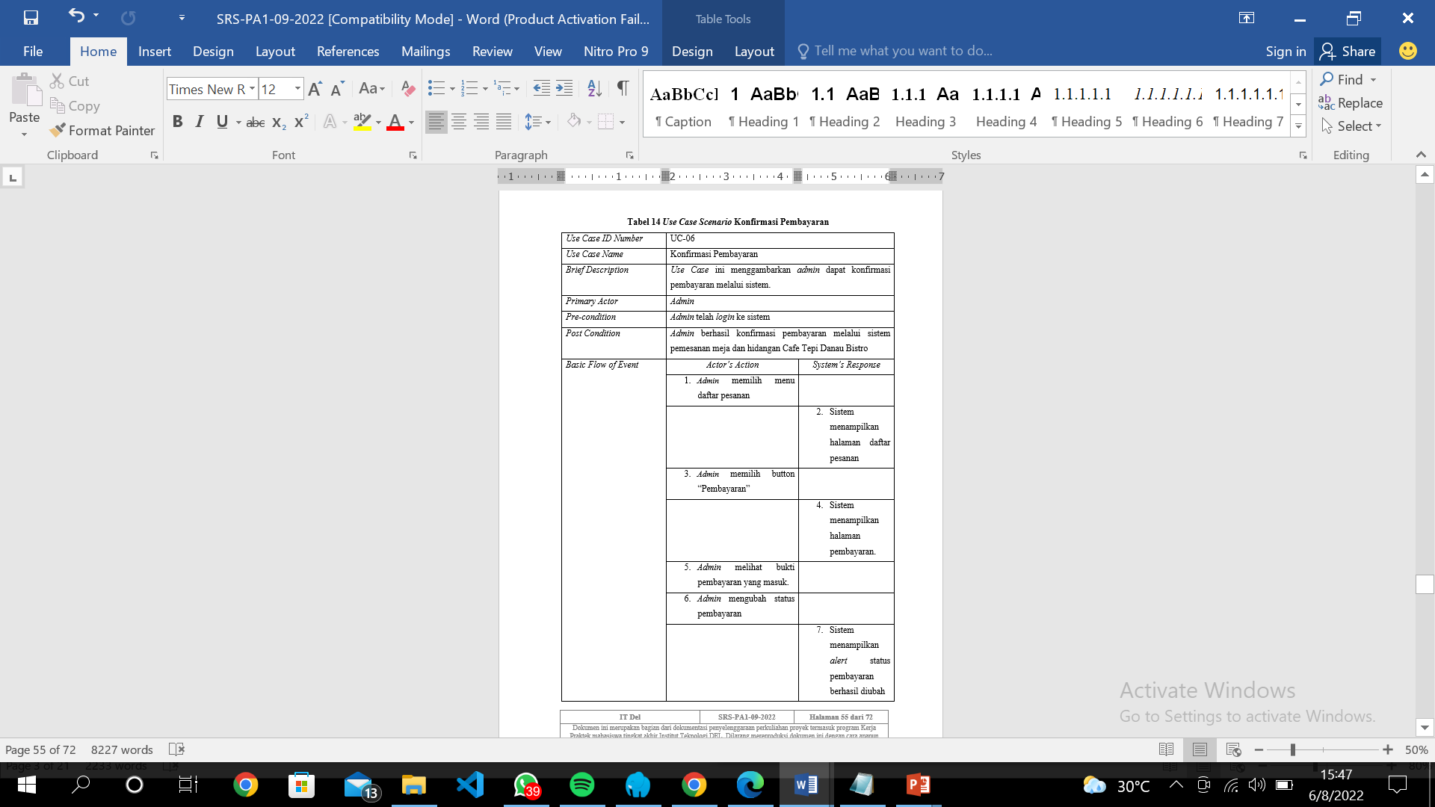
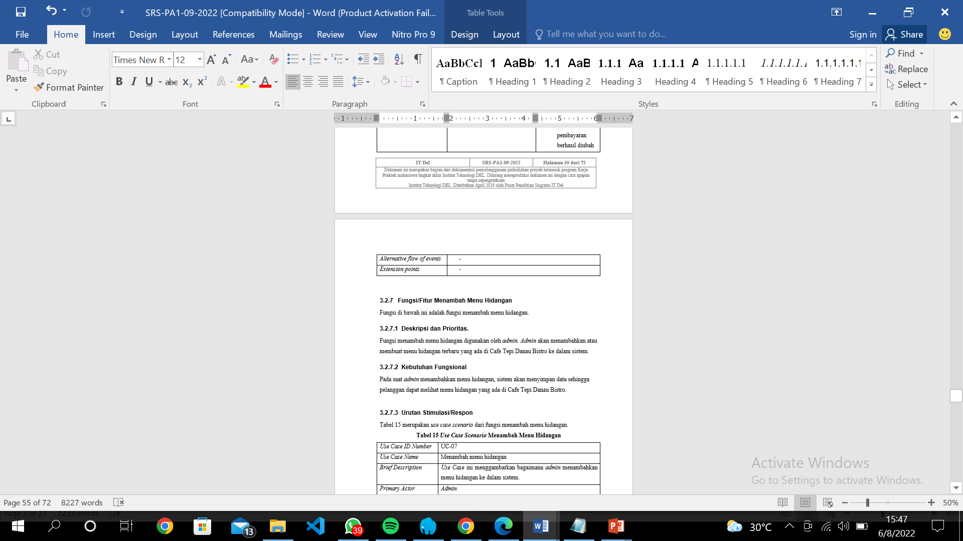
Use Case Scenario
Use Case Scenario For Payment Confirmation

Slide 20
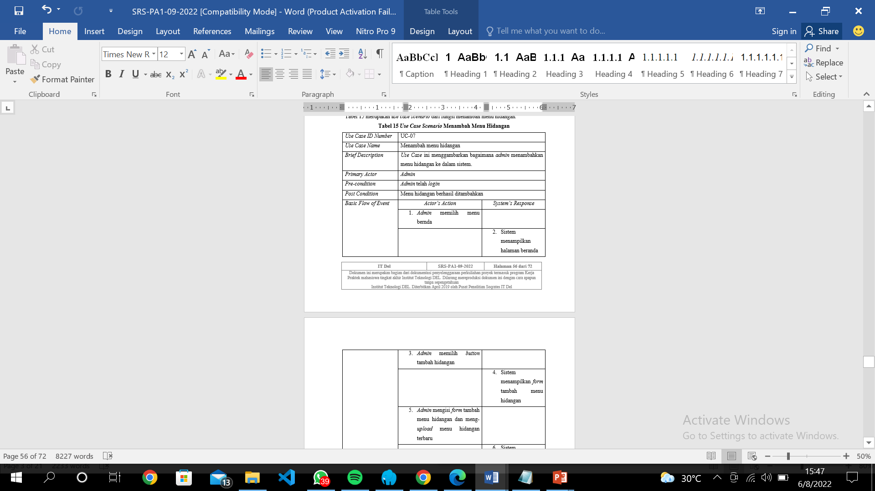
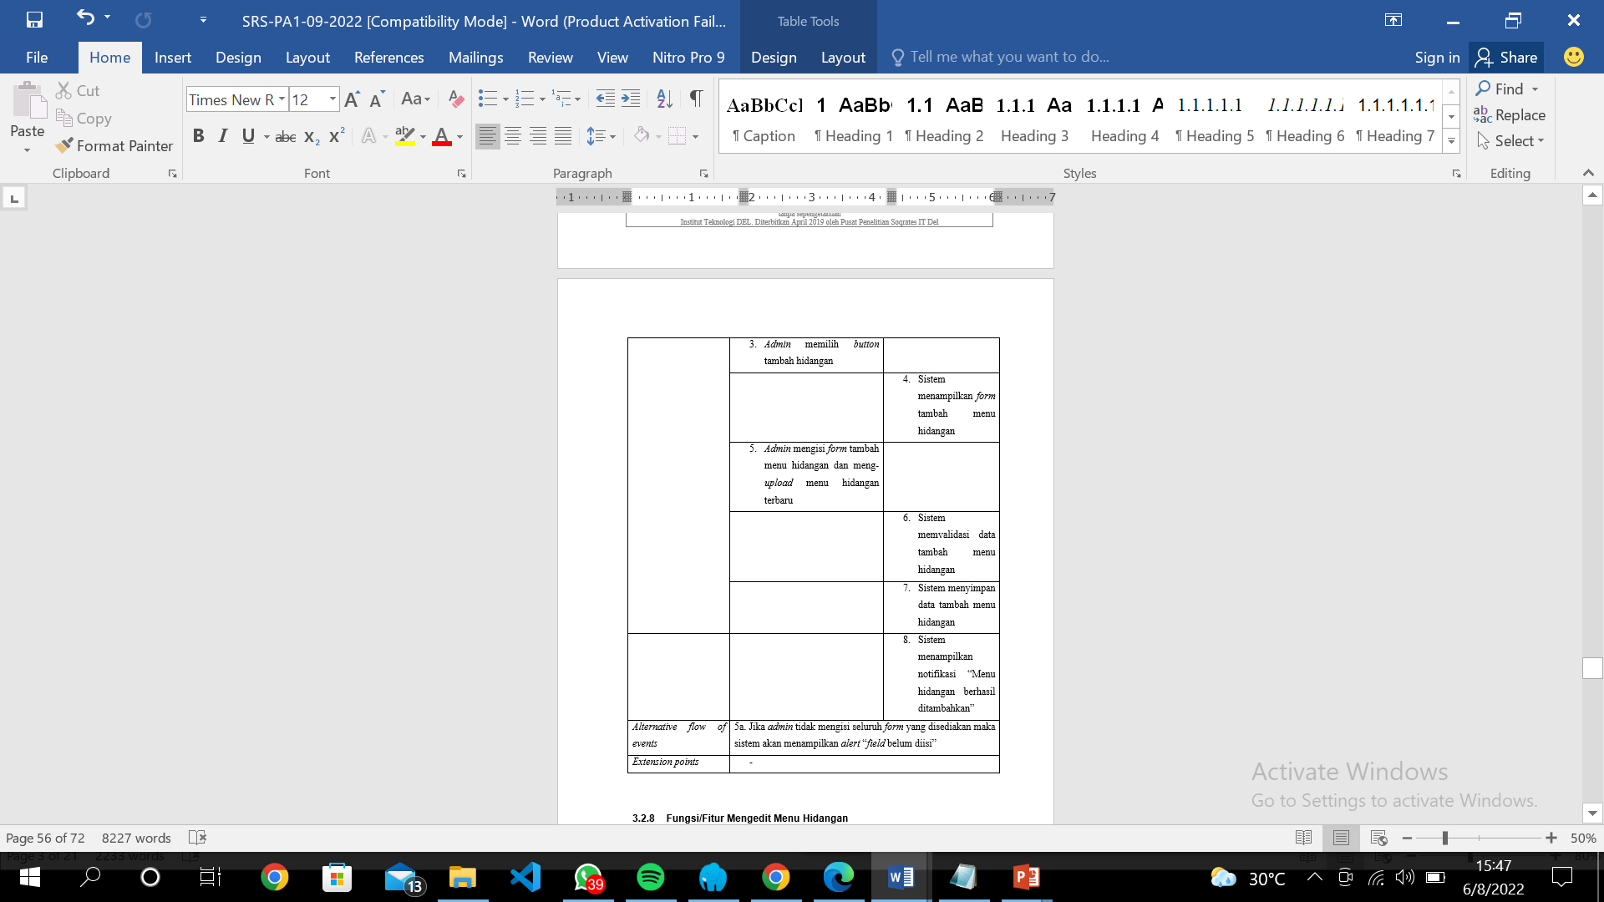
Use Case Scenario
Use Case Scenario For Add The Menu Of Dishes

Slide 21
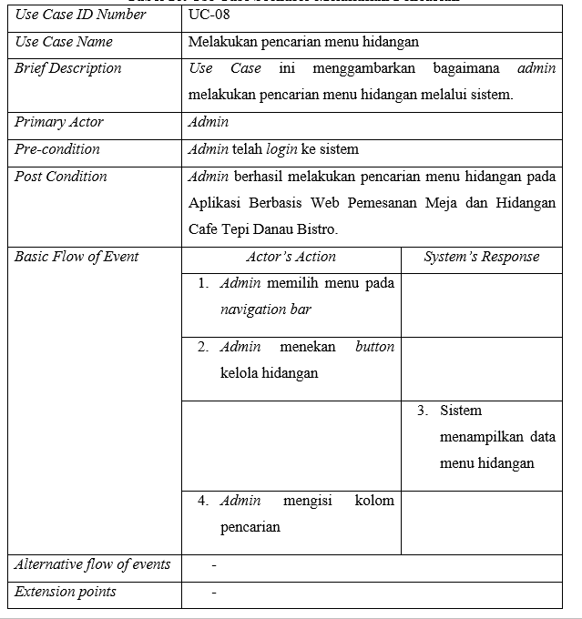
Use Case Scenario
Use Case Scenario Search For a Menu of Dishes

Slide 22
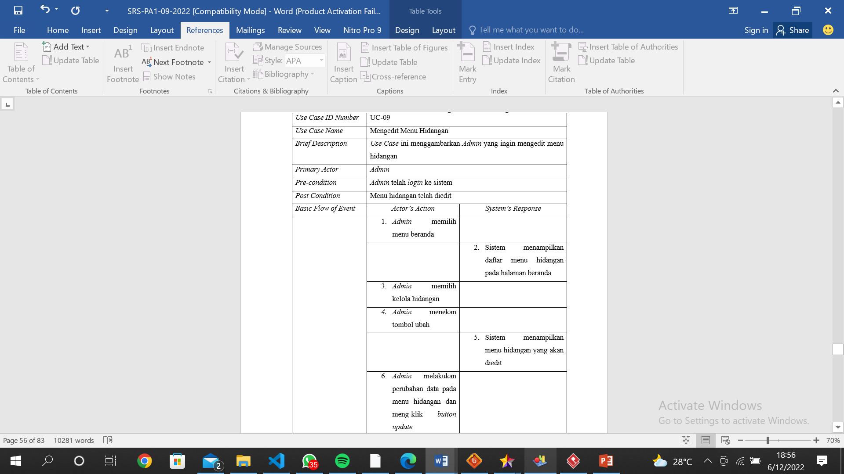
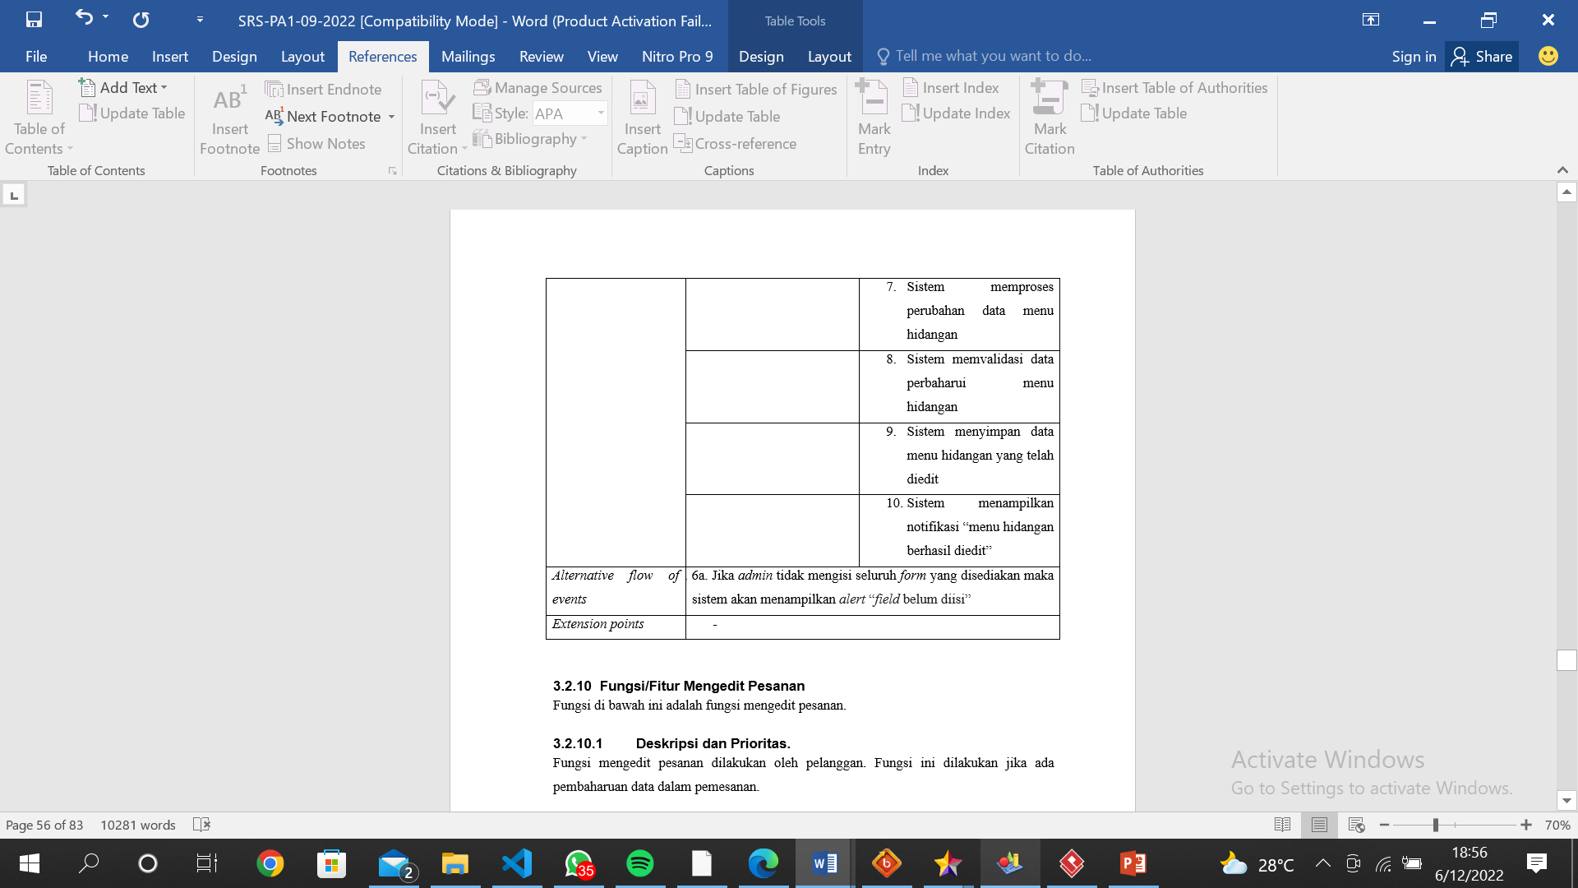
Use Case Scenario
Use Case Scenario For Update The Menu Of Dishes

Slide 23
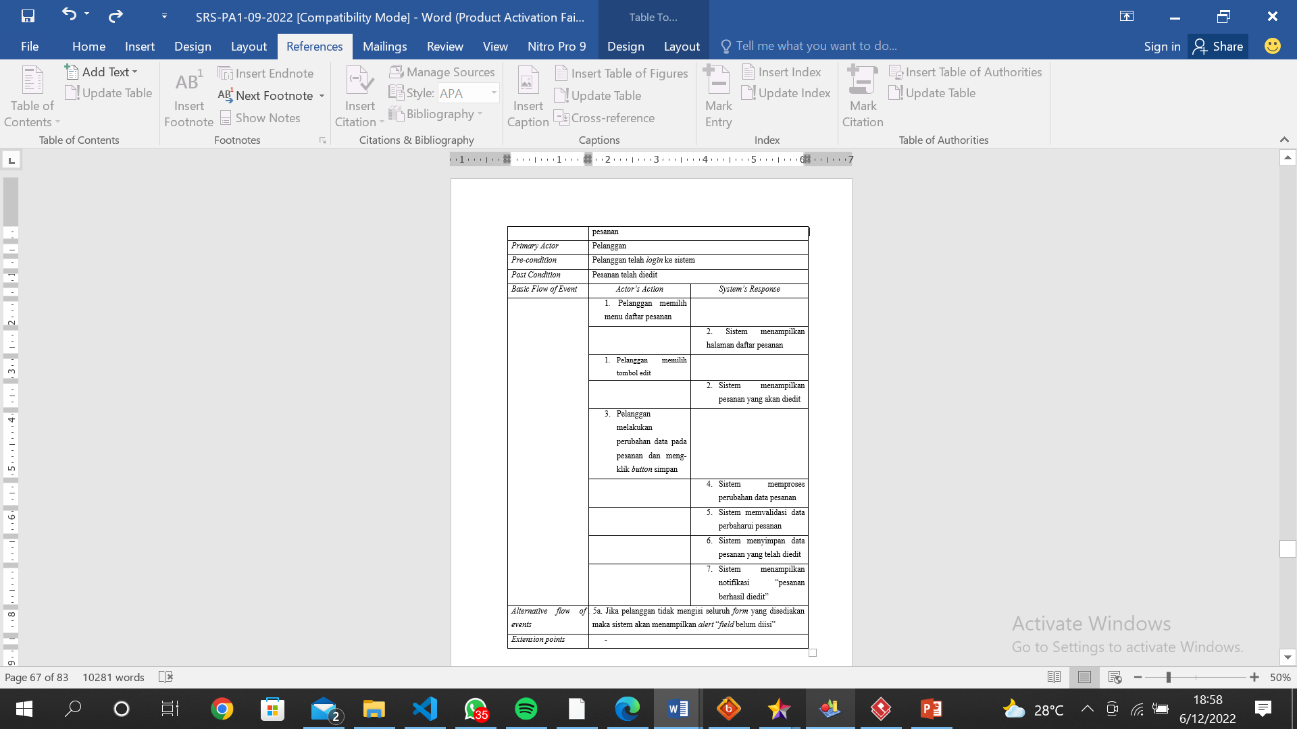
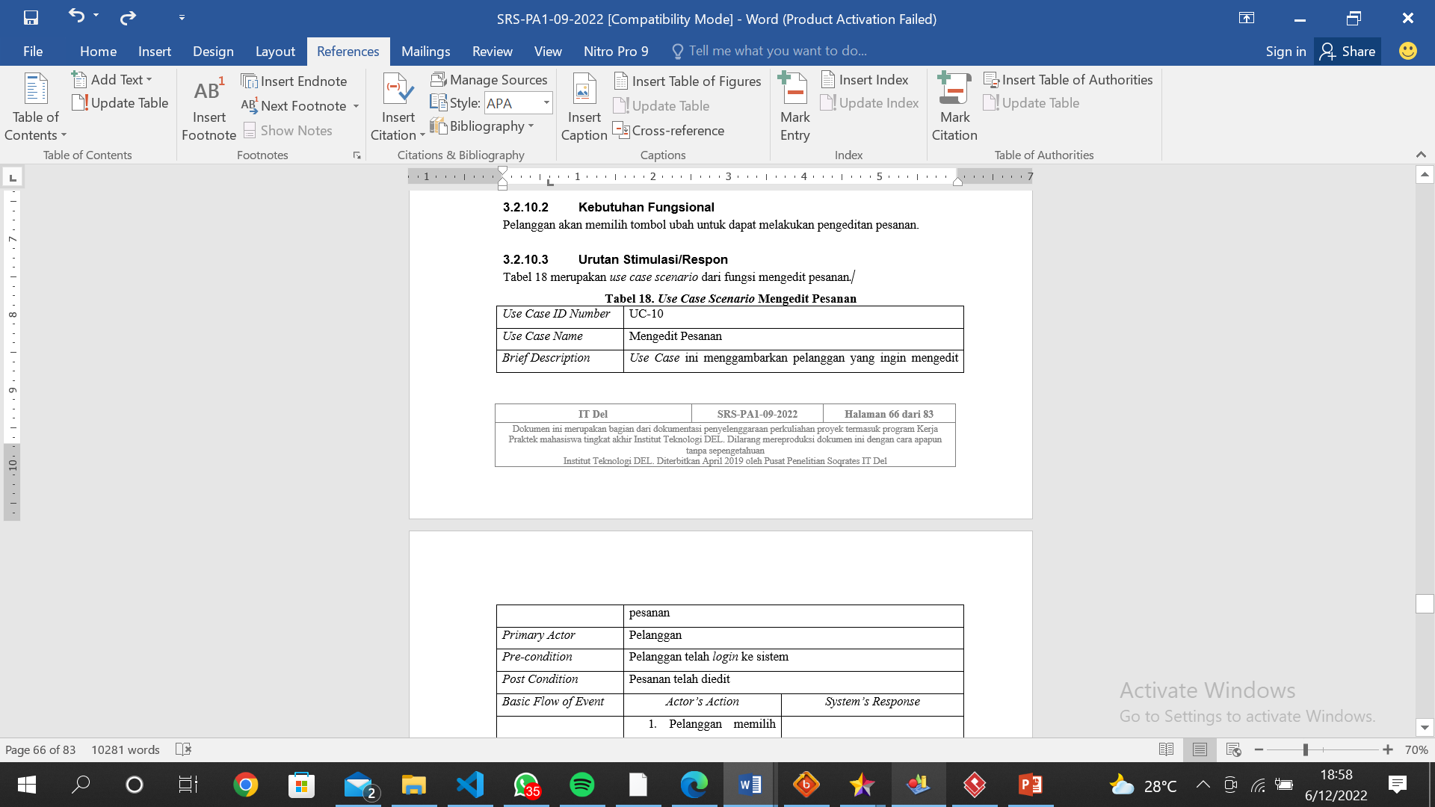
Use Case Scenario
Use Case Scenario Update of Orders

Slide 24
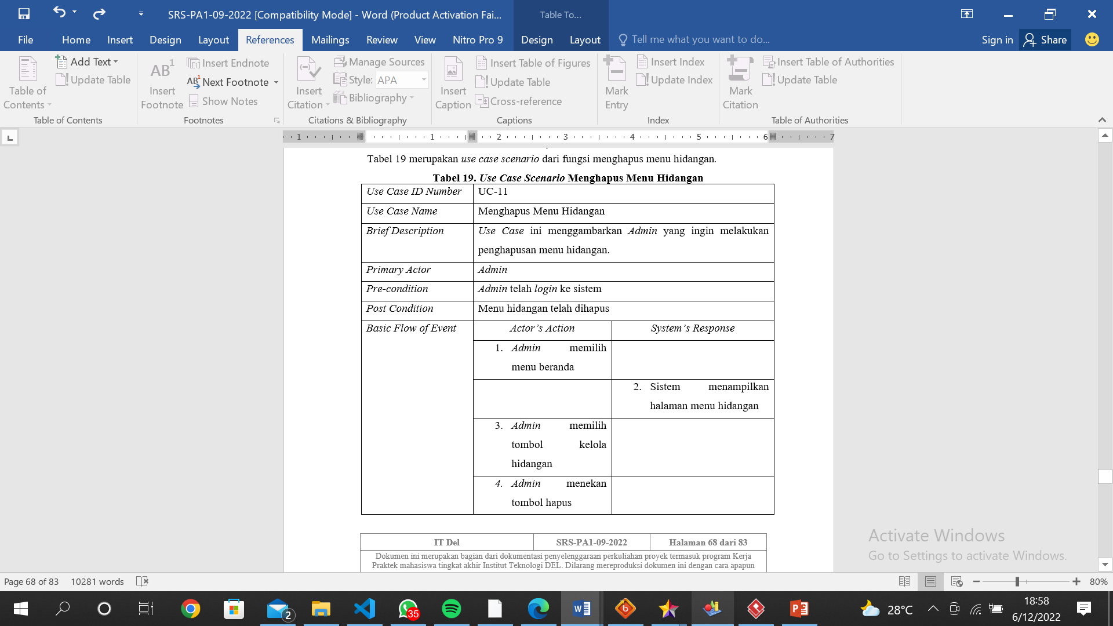
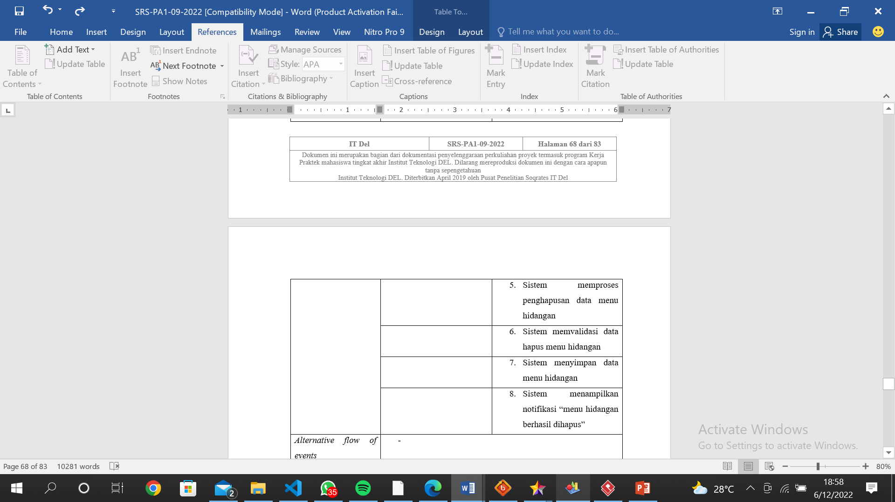
Use Case Scenario
Use Case Scenario For Delete The Menu Of Dishes

Slide 25
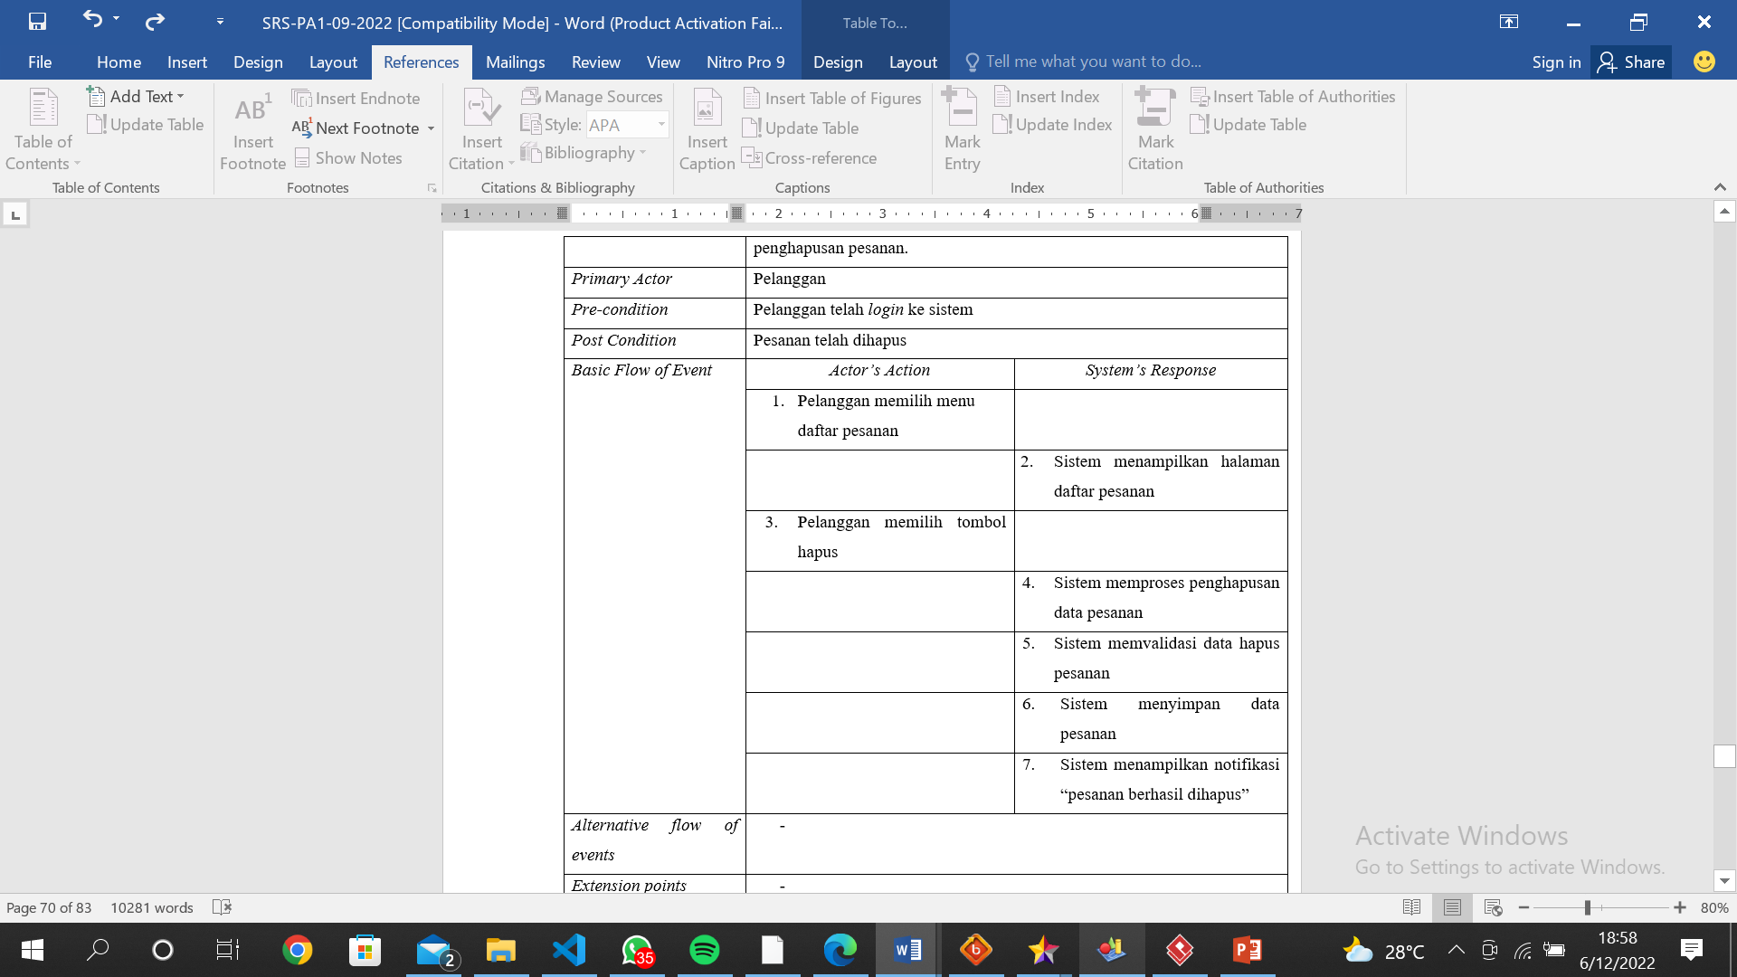
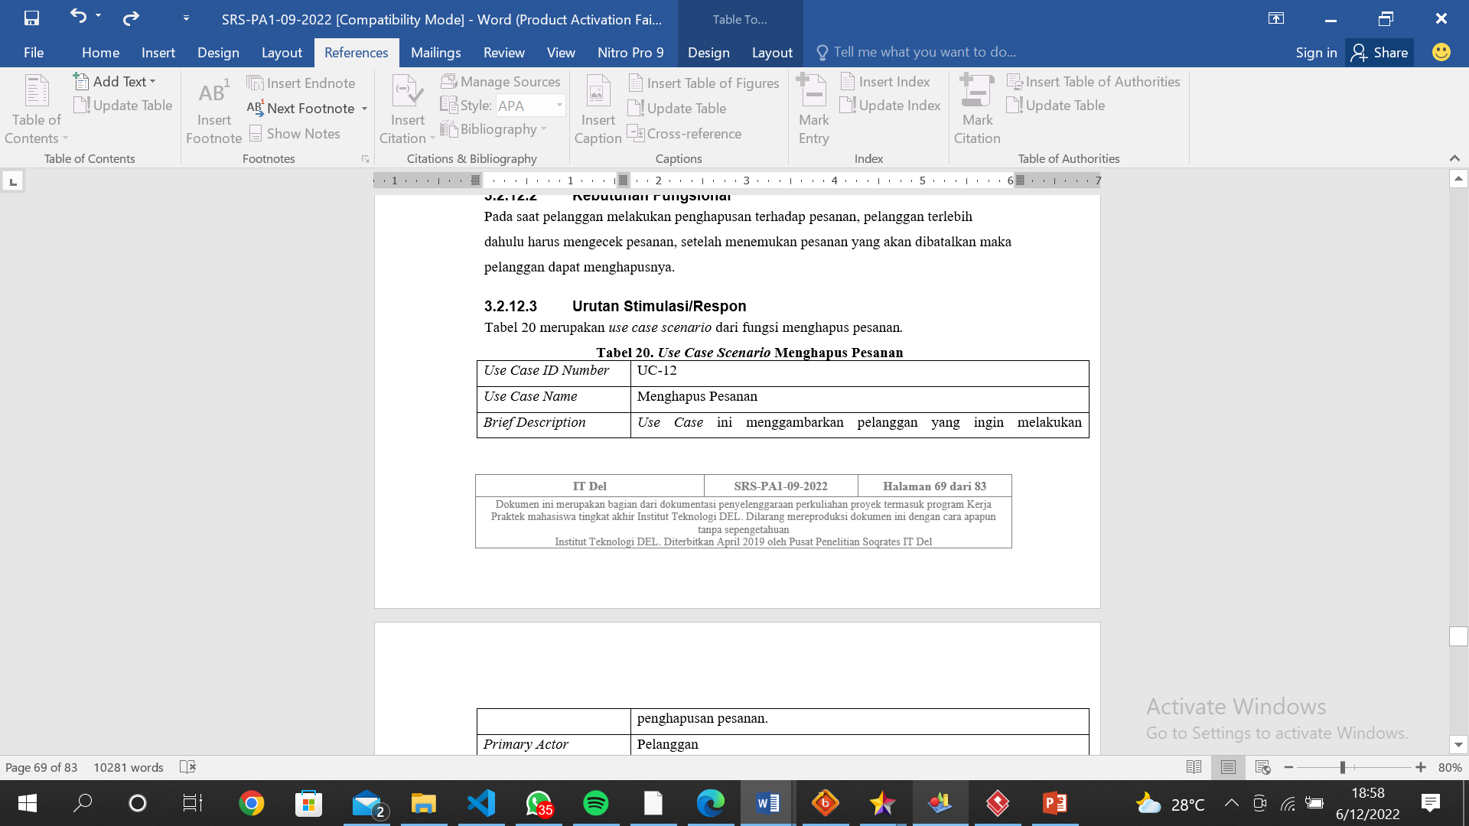
Use Case Scenario
Use Case Scenario For Delete of Orders

Slide 26
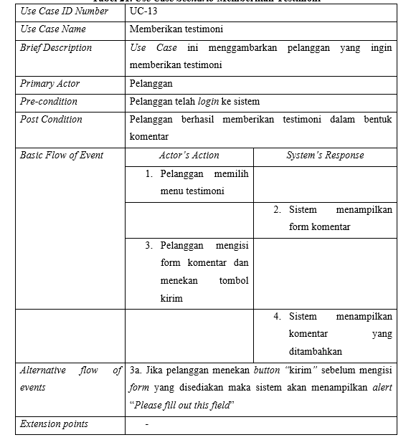
Use Case Scenario
Use Case Scenario For Providing Testimonials

Slide 27
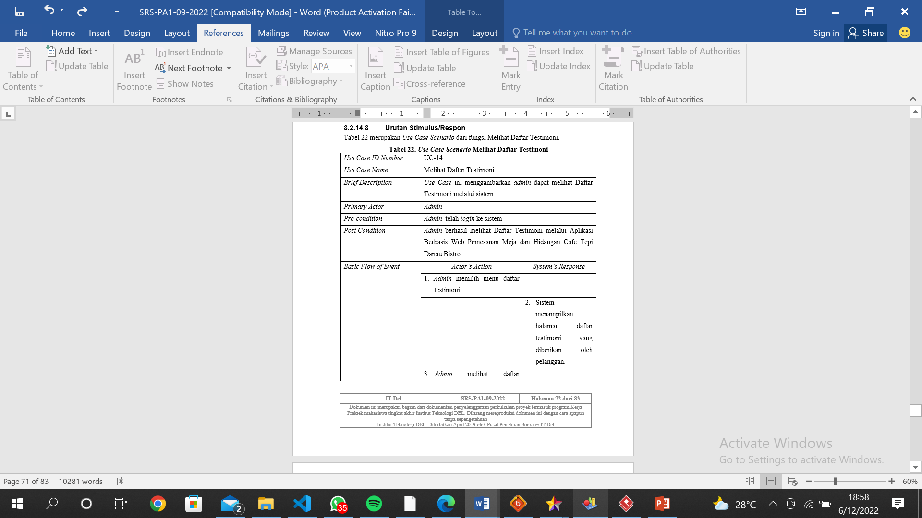
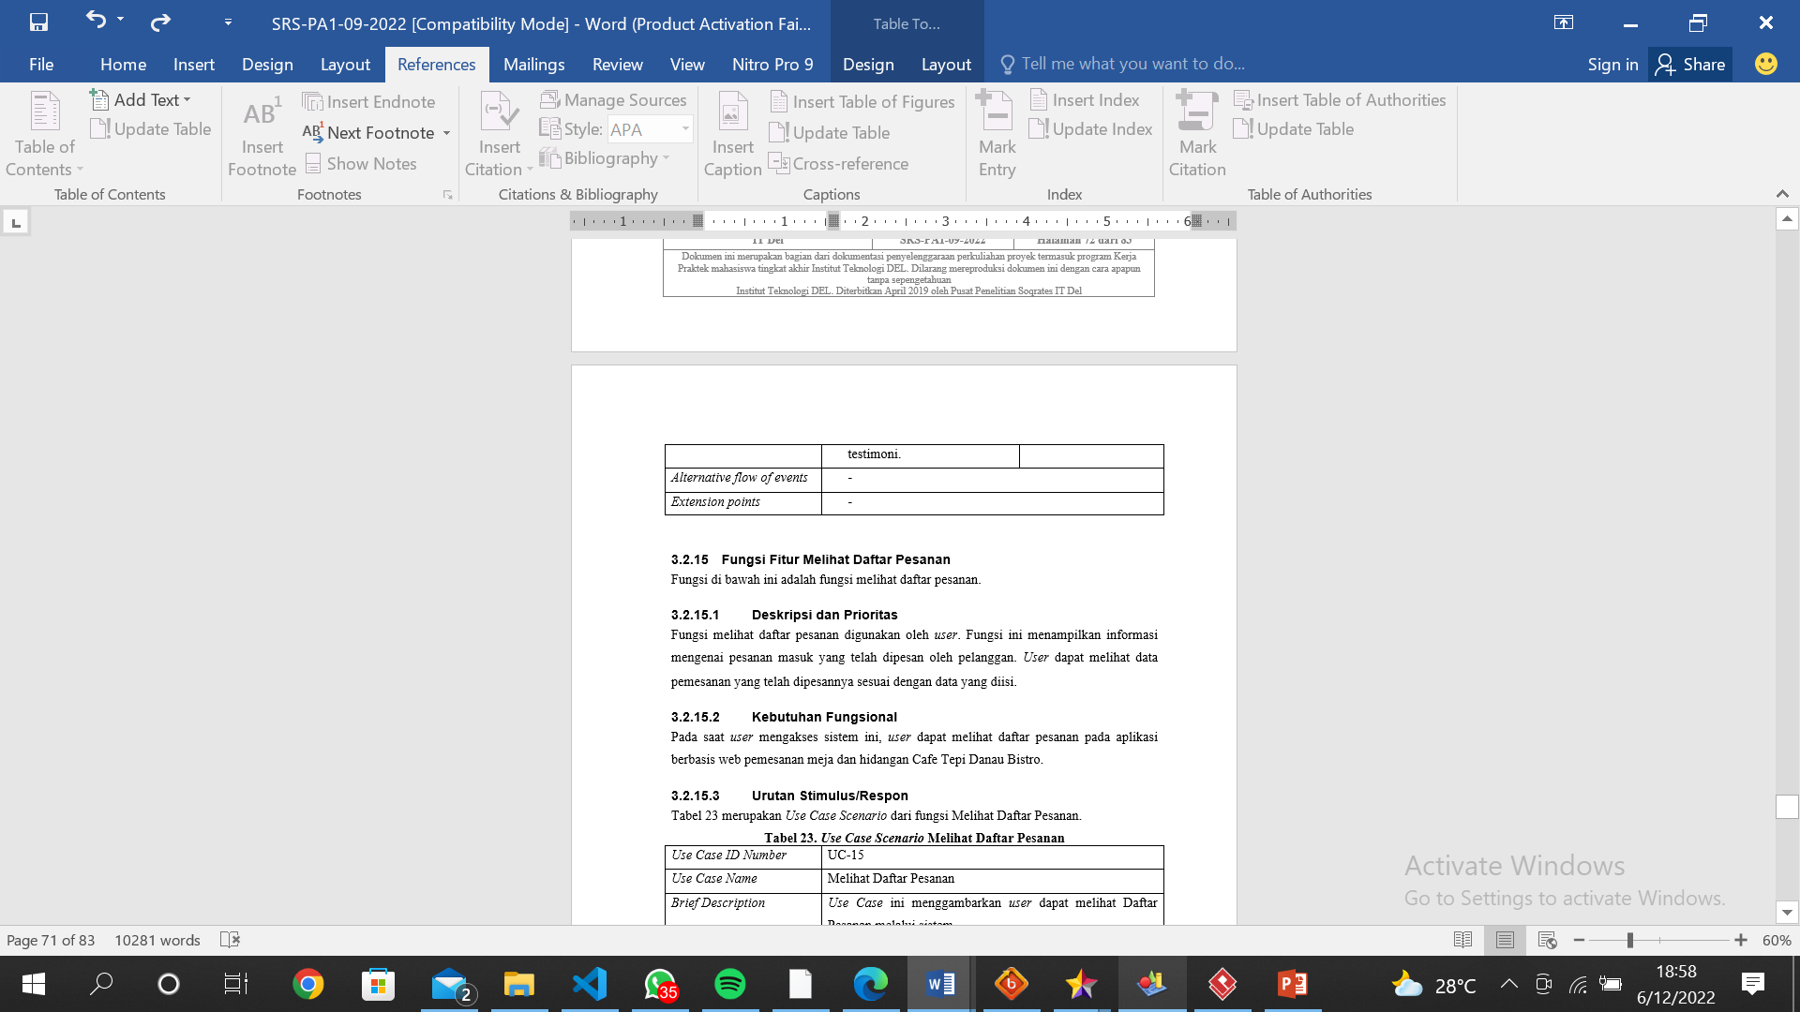
Use Case Scenario
Use Case Scenario View Testimonial List

Slide 28
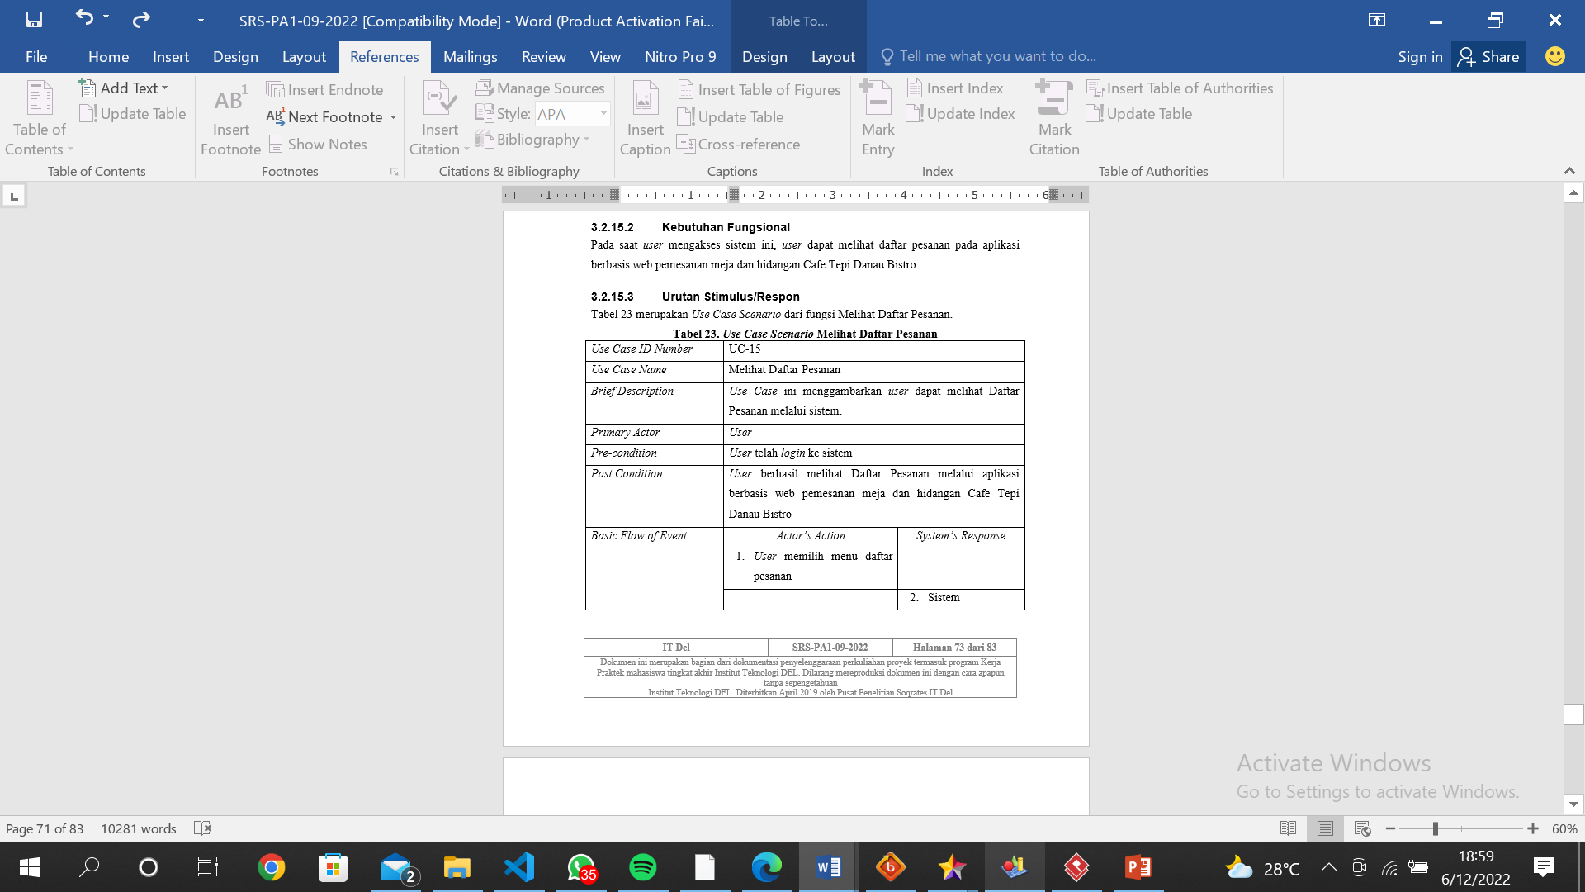
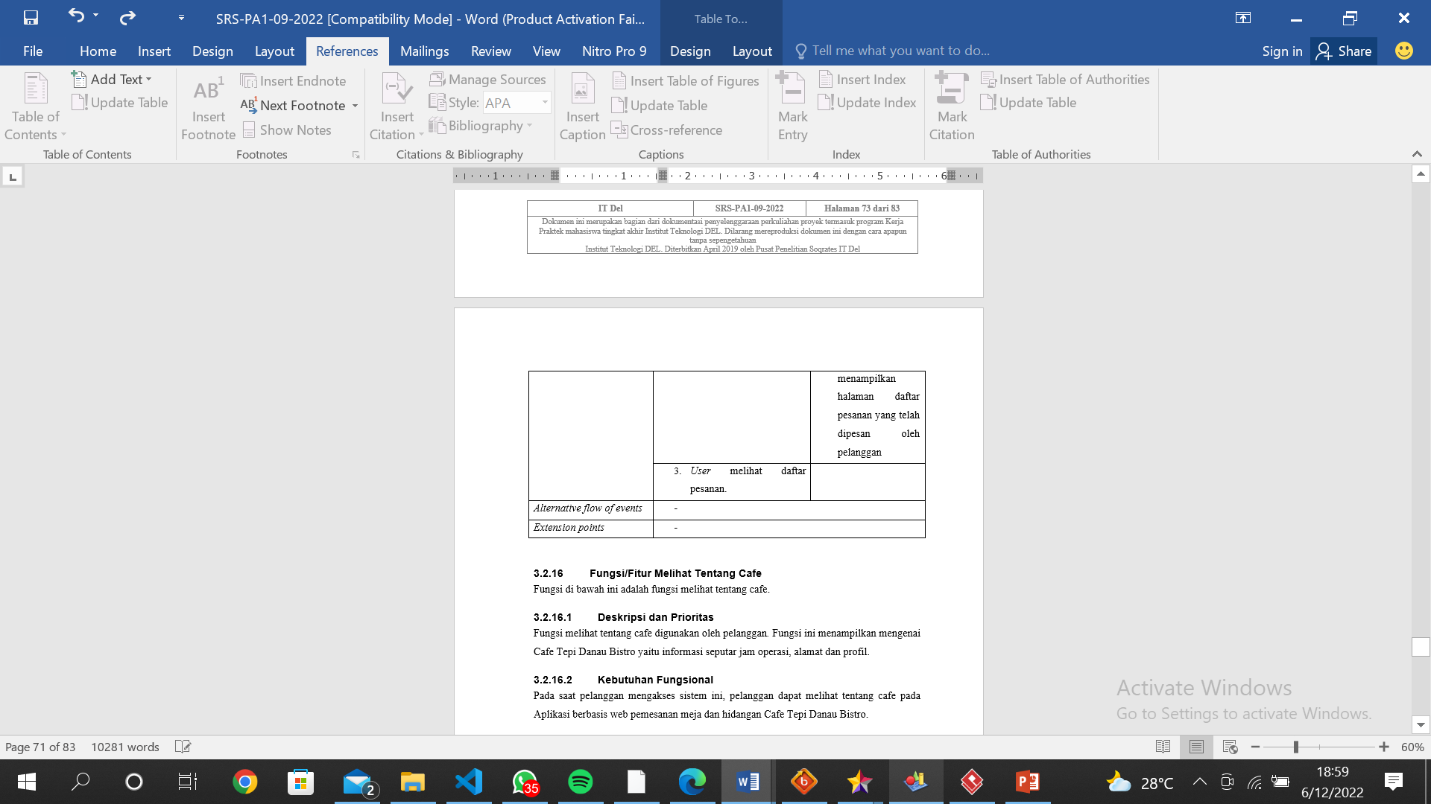
Use Case Scenario
Use Case Scenario View Order List

Slide 29
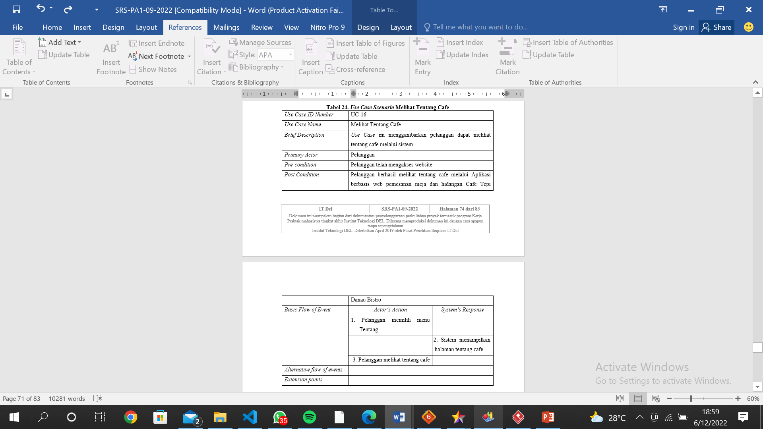
Use Case Scenario
Use Case Scenario View About Cafe

Slide 30
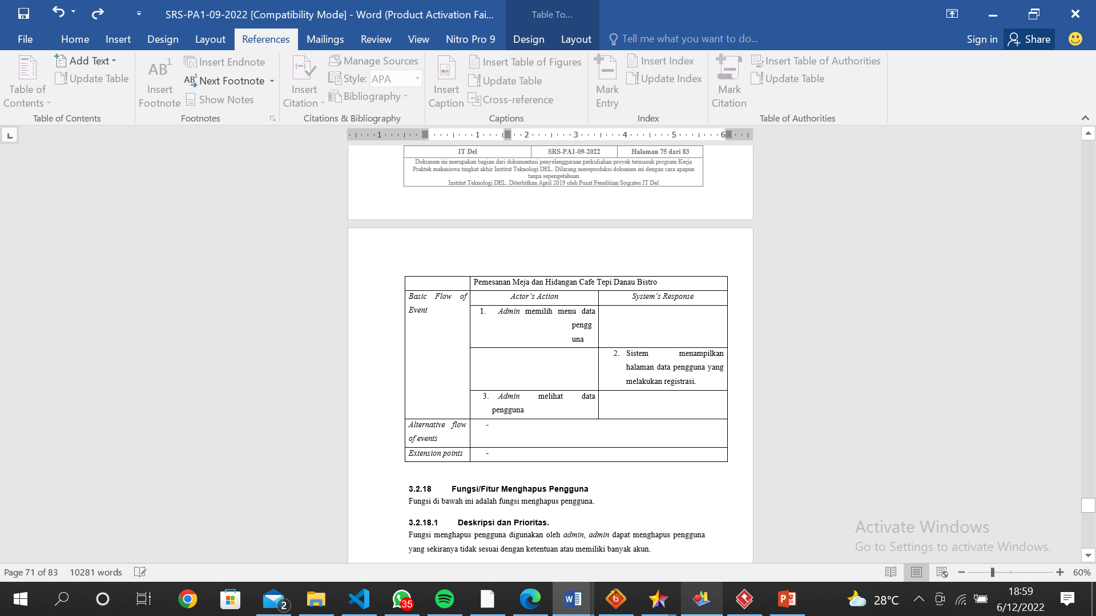
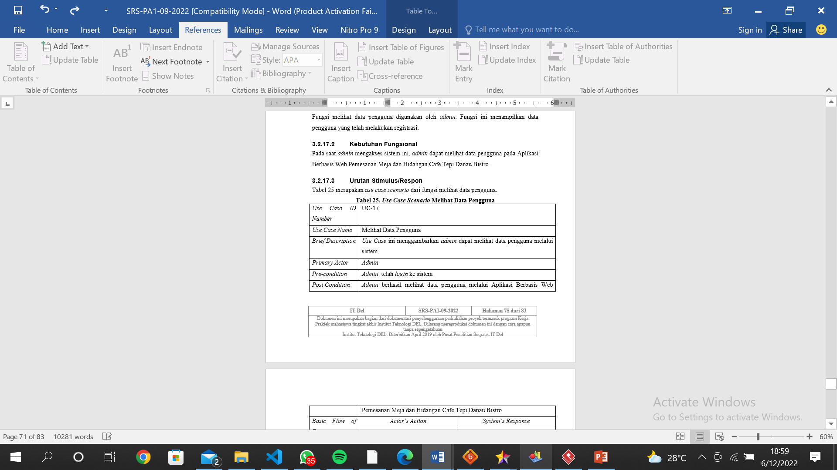
Use Case Scenario
Use Case Scenario View User Data

Slide 31
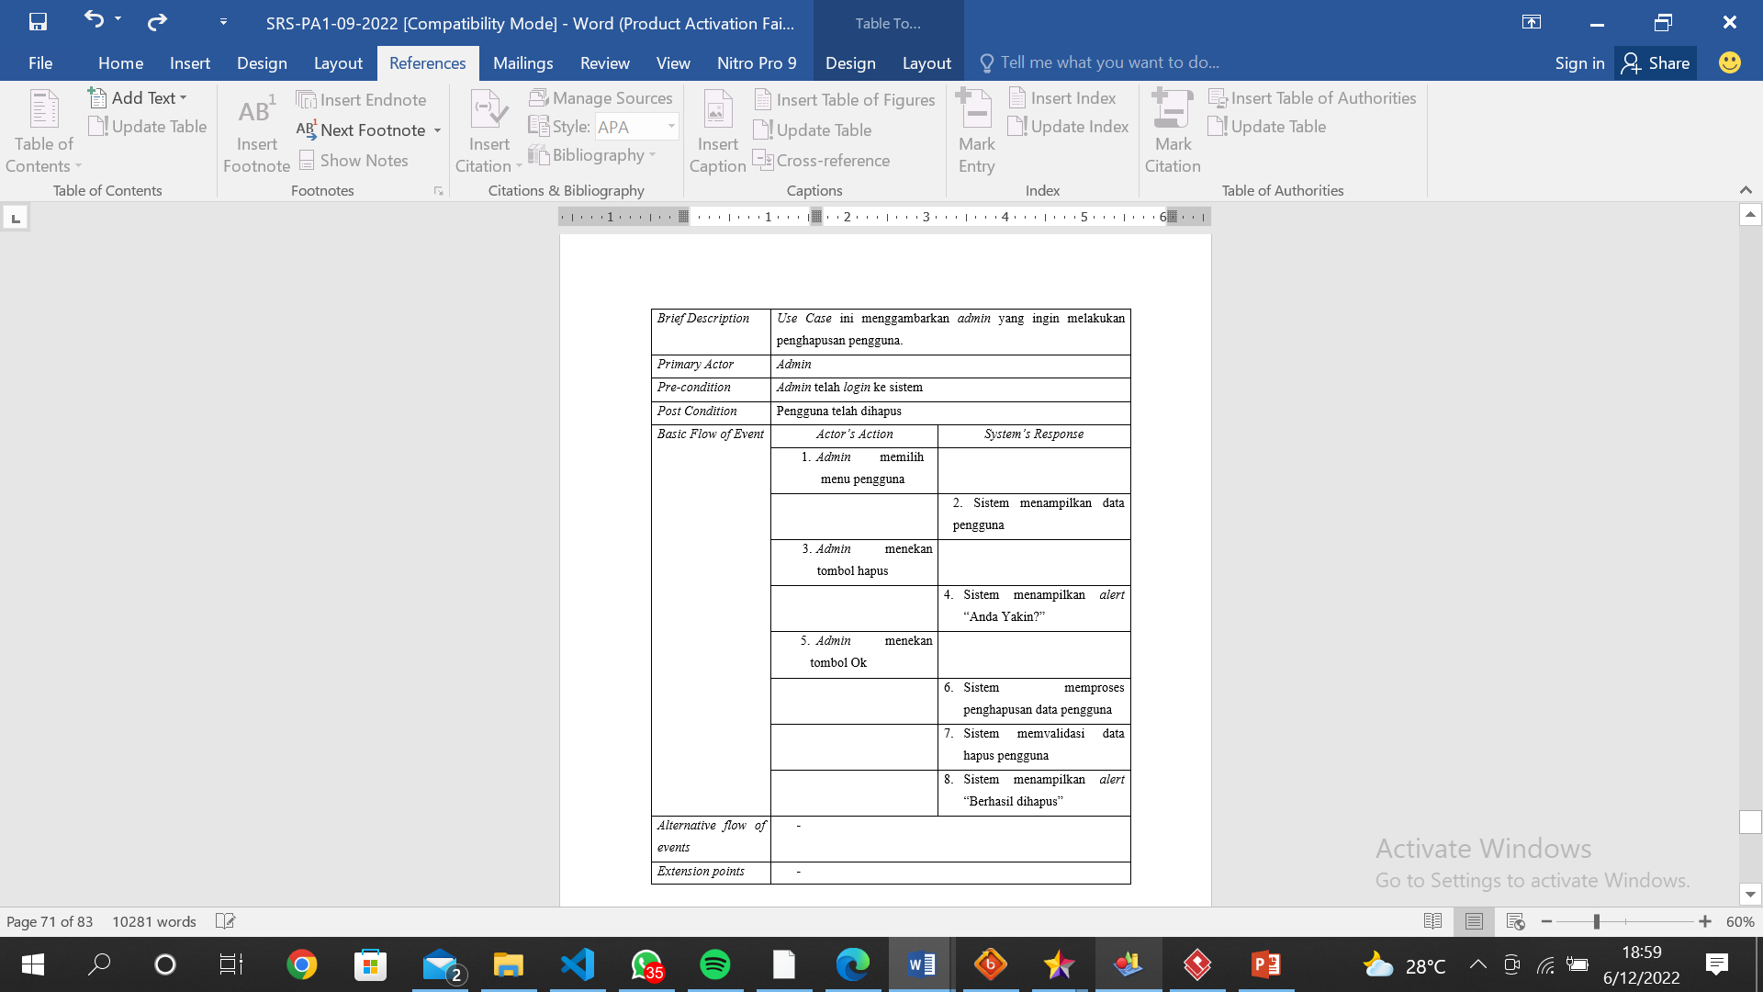
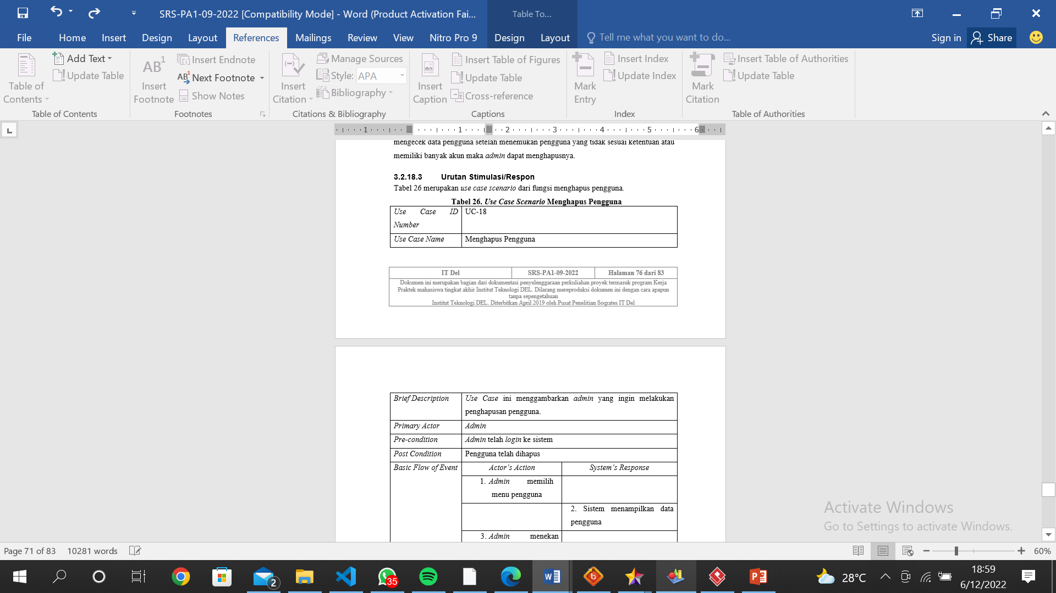
Use Case Scenario
Use Case Scenario Delete User

Slide 32
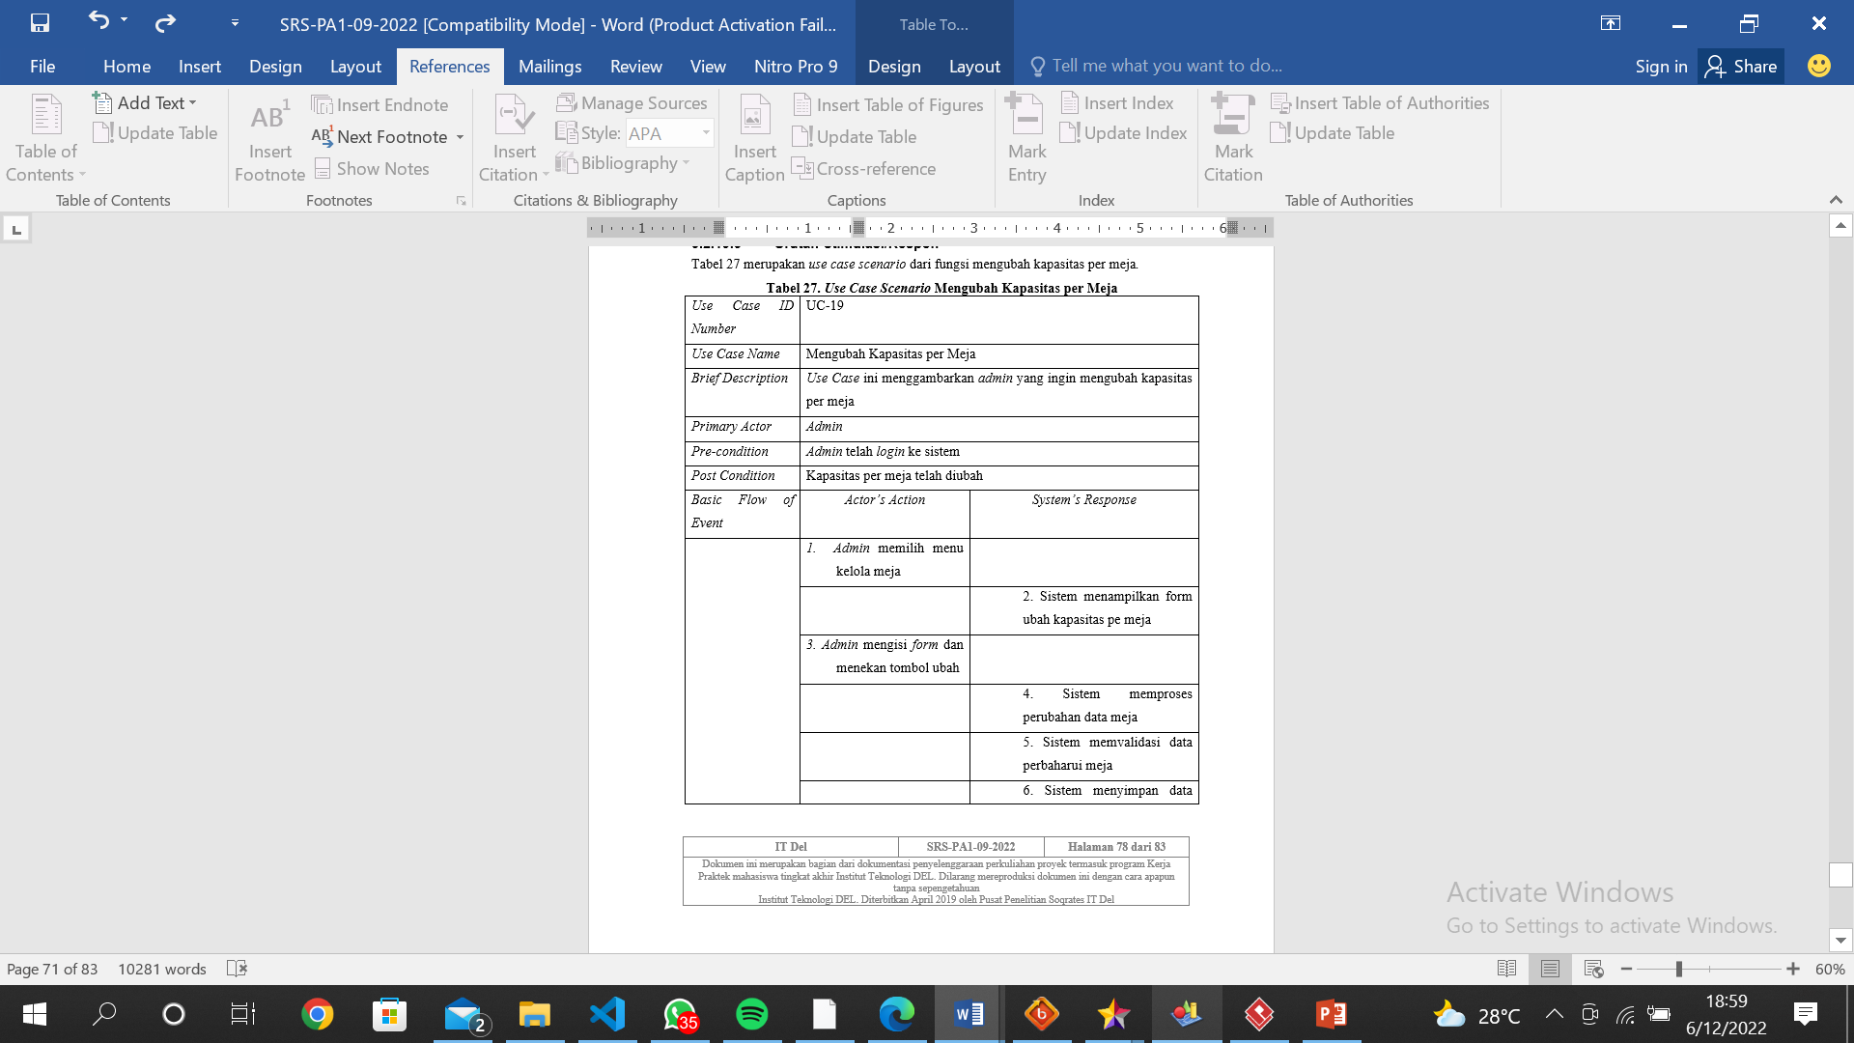
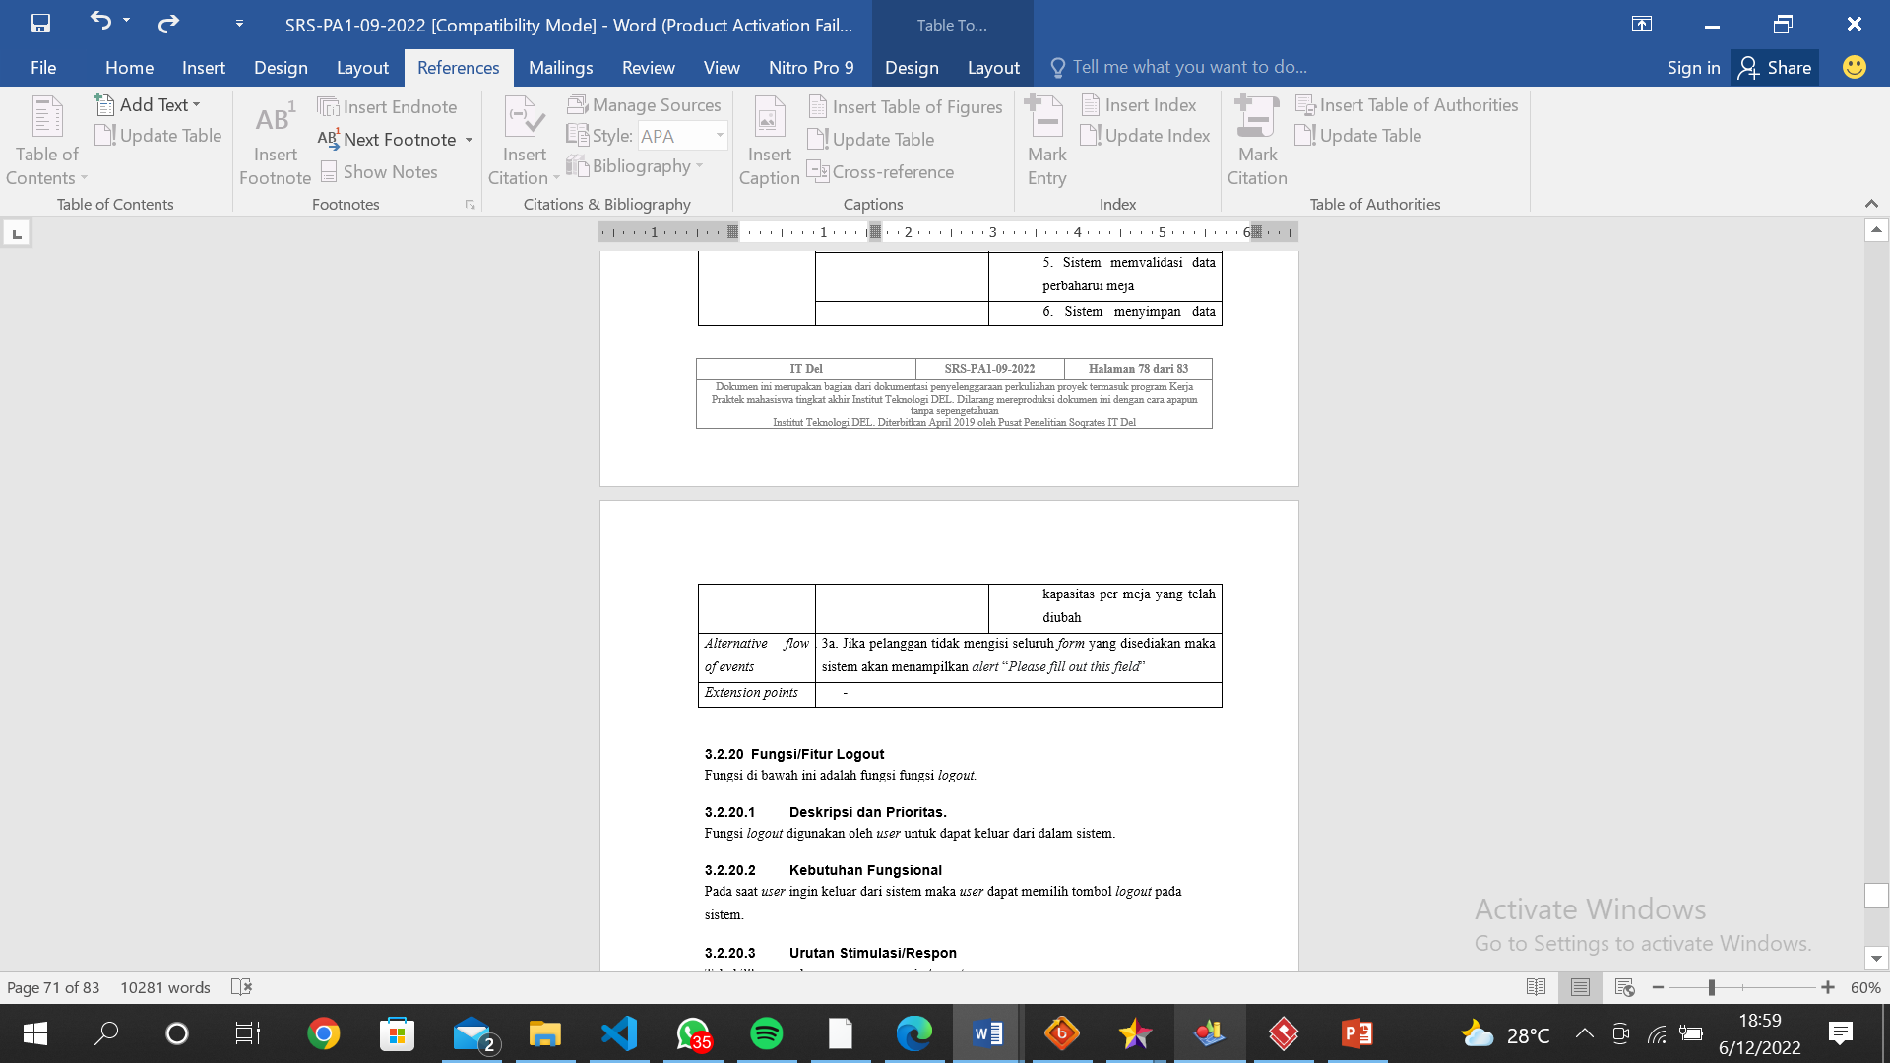
Use Case Scenario
Use Case Scenario Update Capacity per Table

Slide 33
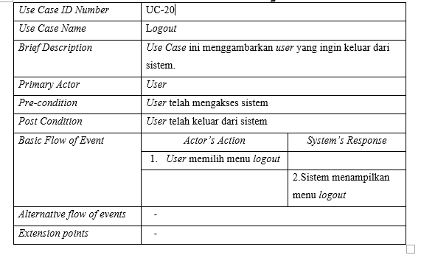
Use Case Scenario
Use Case Scenario Logout

Slide 34
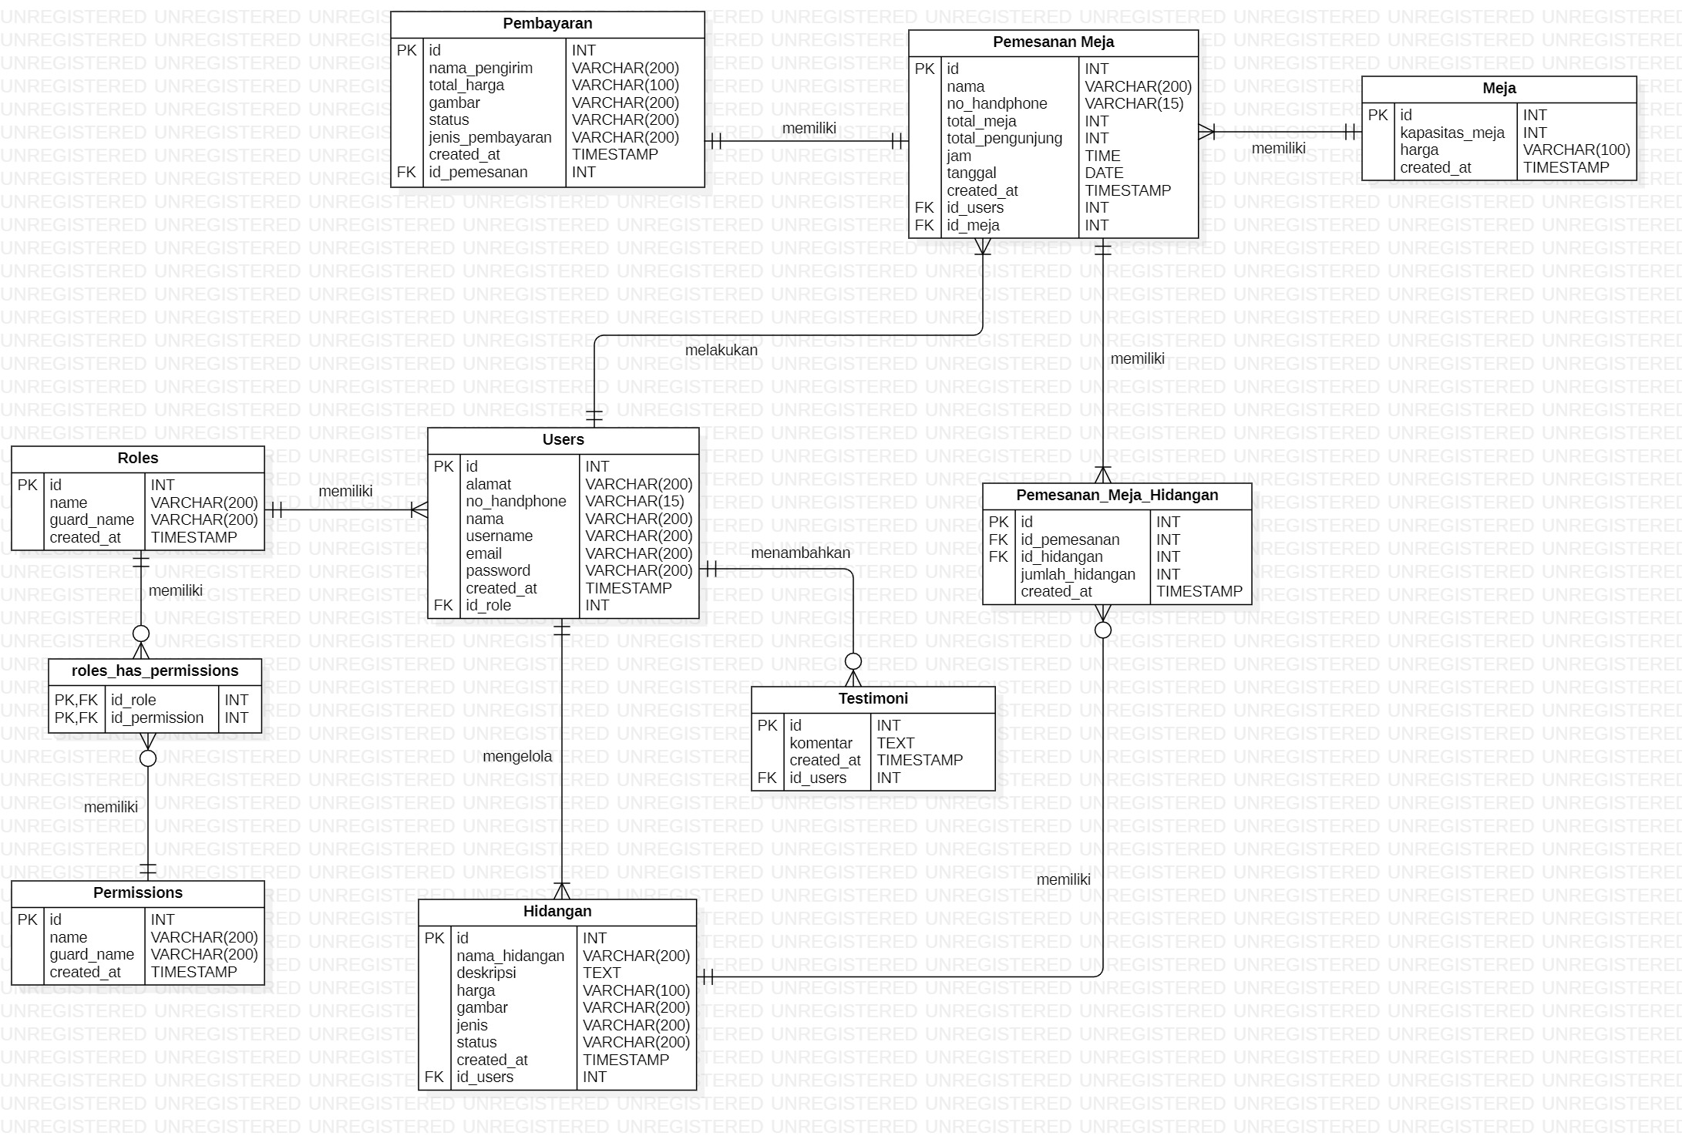
Entity Relationship Diagram

Slide 35
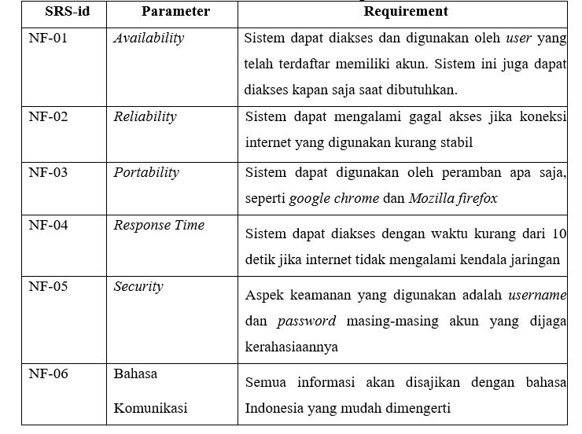
Non-functional Requirements

Slide 36
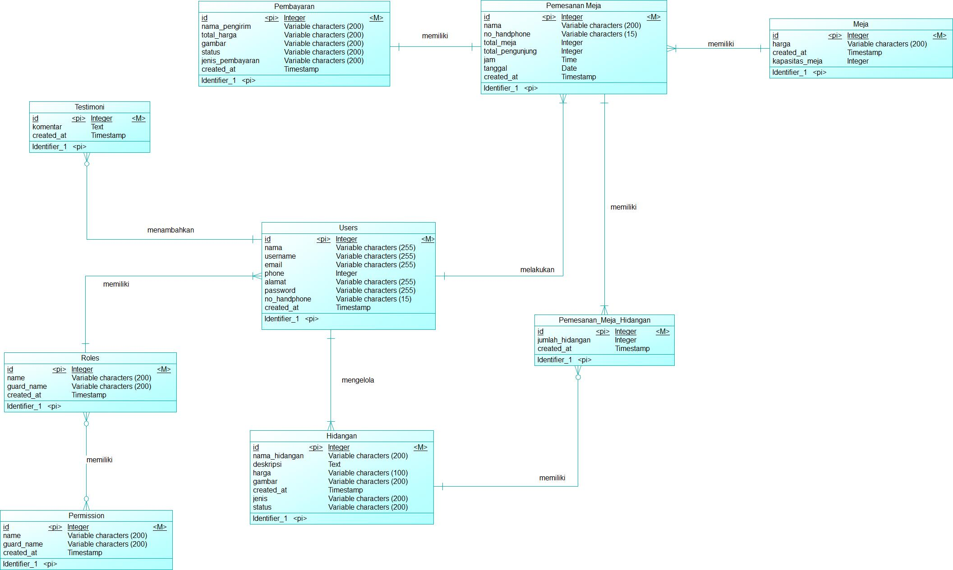
Conseptual Data Model

Slide 37
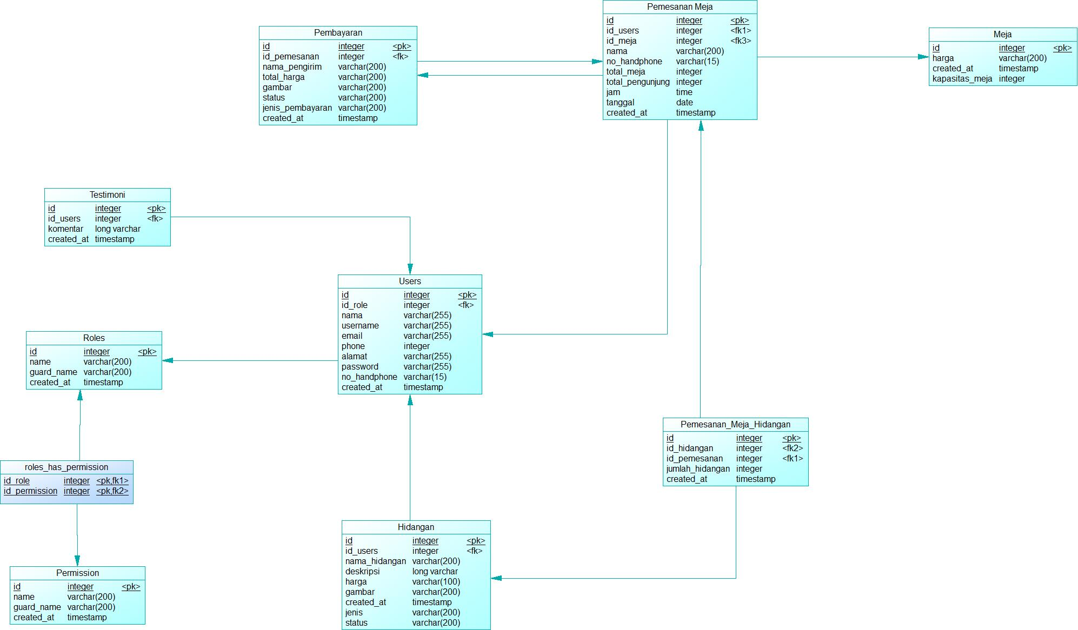
Physical Data Model

Slide 38
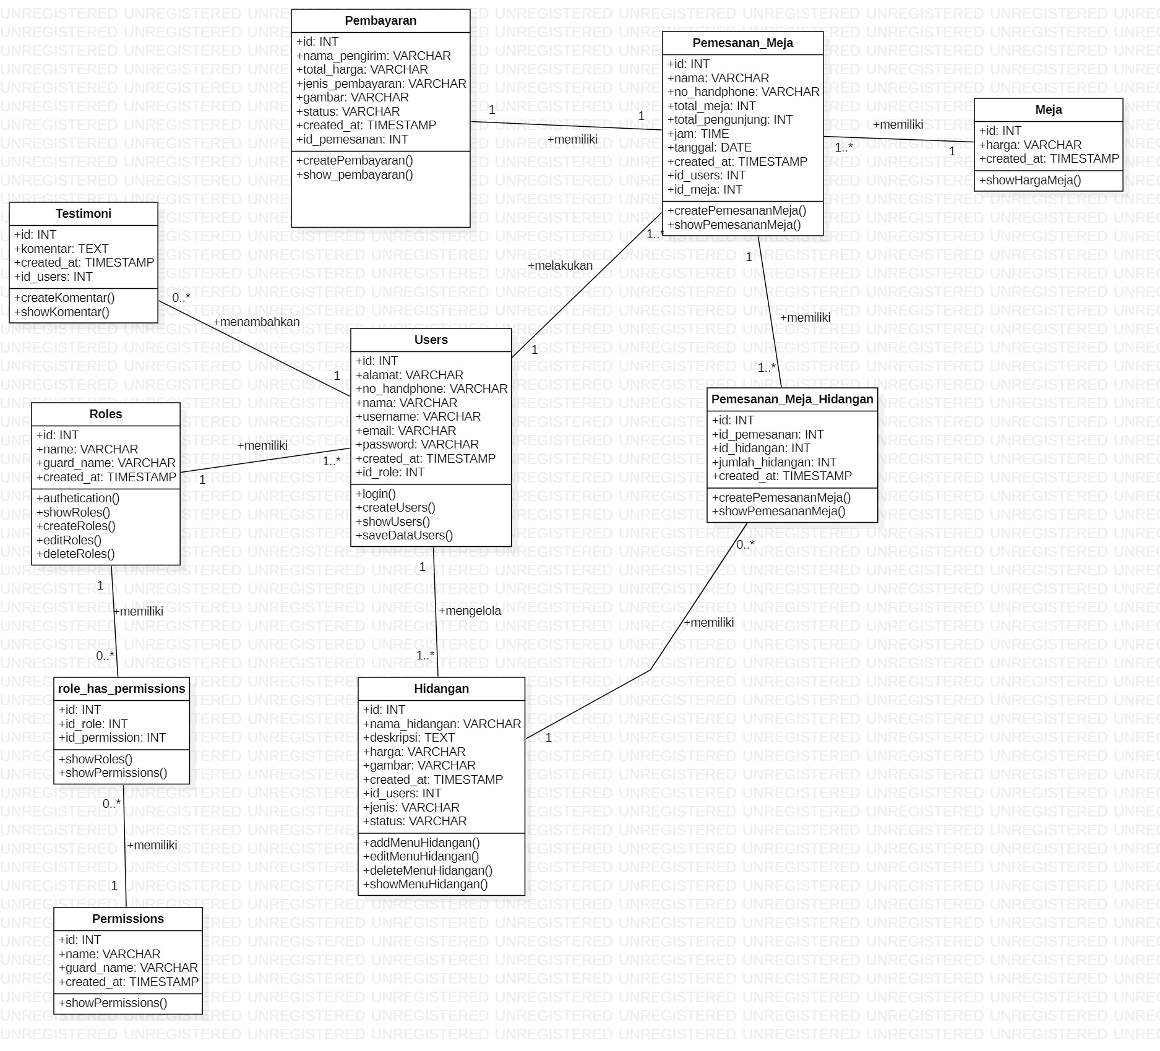
Class Diagram

Slide 39
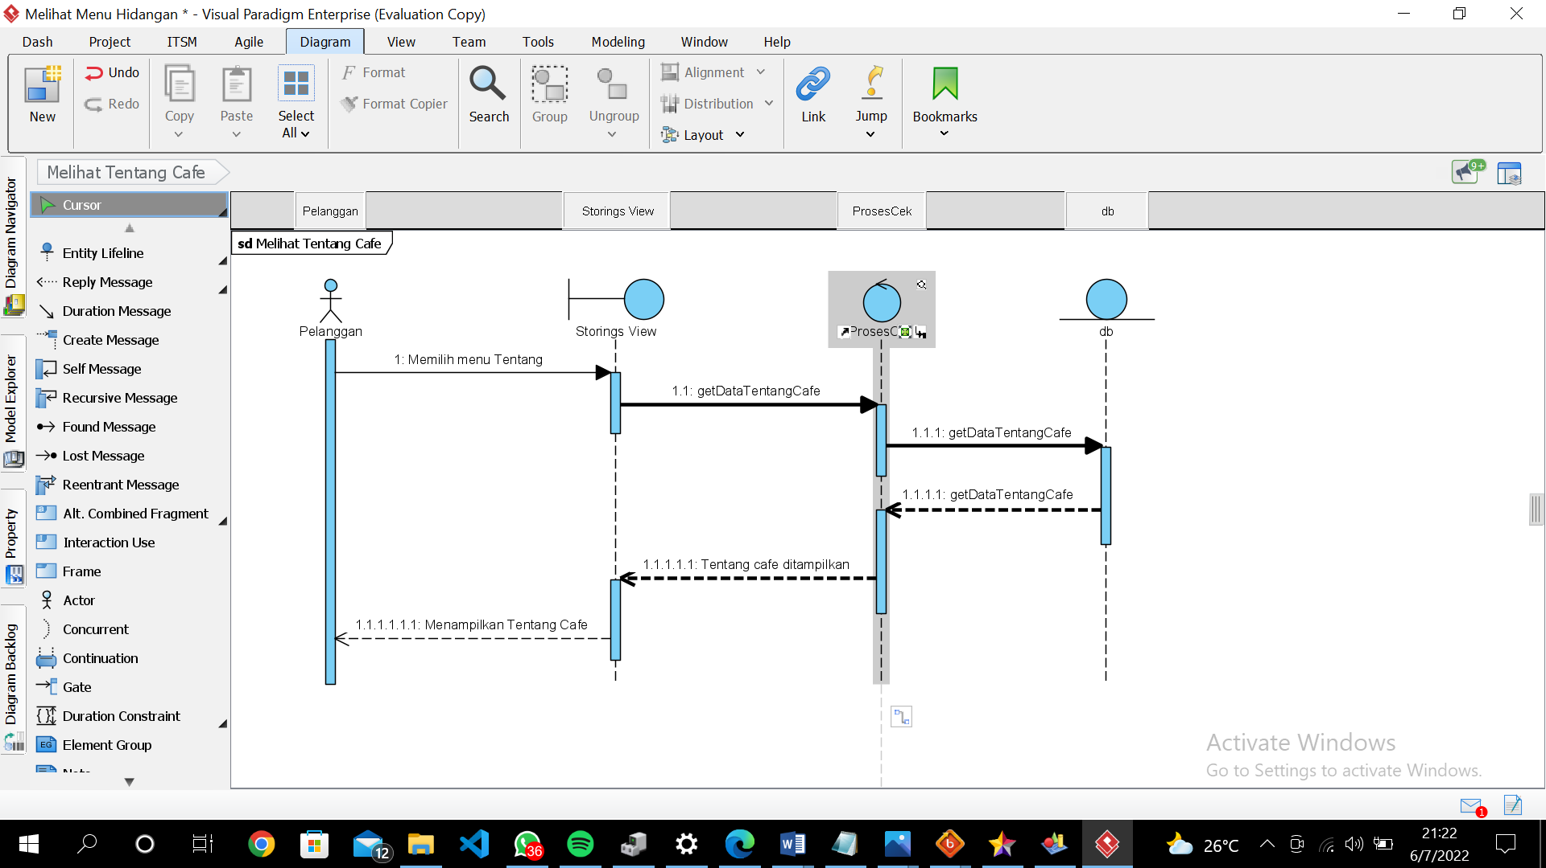
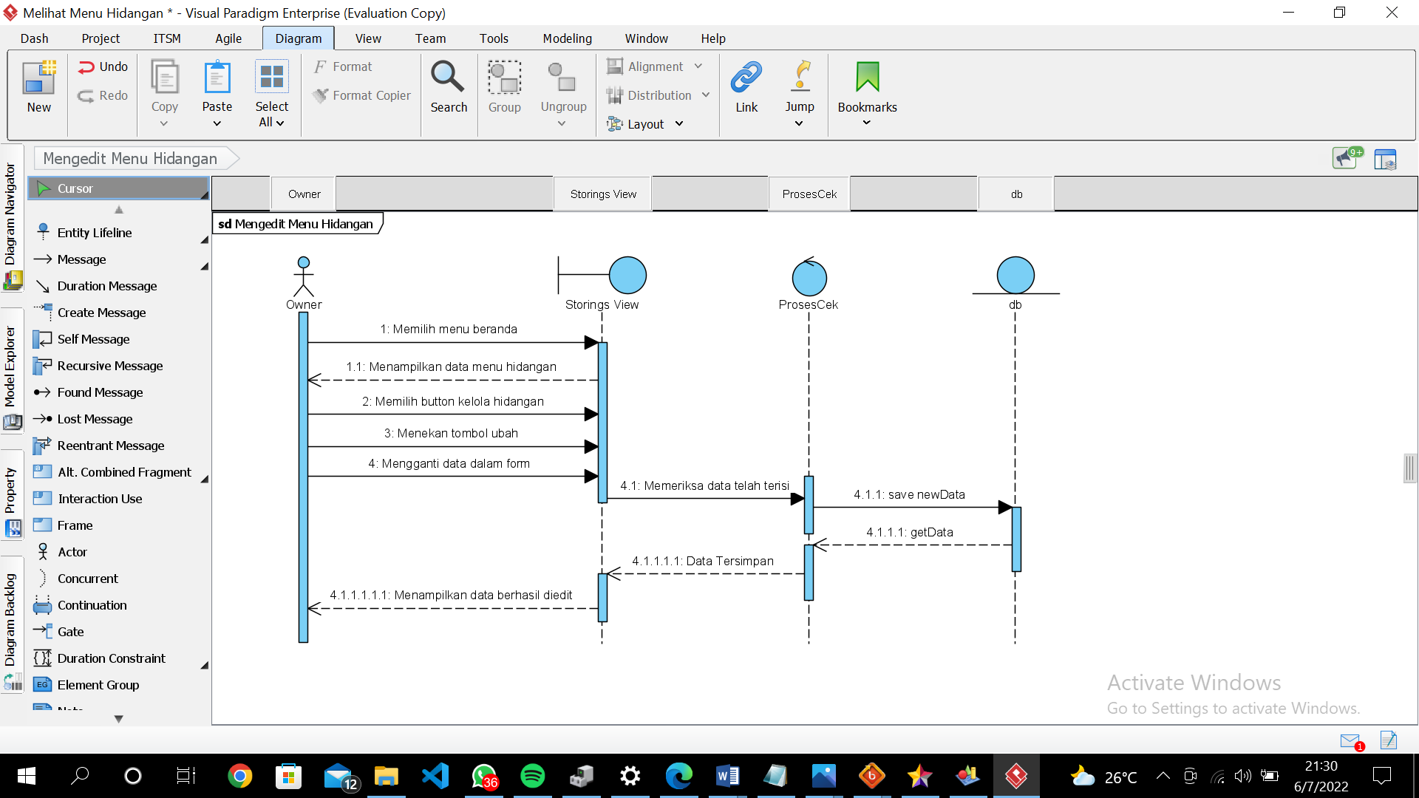
Sequence Diagram
Sequence Diagram Update The Menu of Dishes
Sequence Diagram View About Cafe

Slide 40

Package Diagram

Slide 41


Test Script & Result
Test script & result add the menu of dishes
Test script & result table and dish reservations

Slide 42
Conclusion
Web-Based Application for Ordering Tables and Dishes of Cafe Tepi Danau Bistro, aims to make it easier for customers to find out information such as dish menus, profiles, addresses and operating hours of Cafe Tepi Danau Bistro and make orders to be more effective without requiring a long time.

Slide 43
DEMO PRODUCT

Slide 44
THANK YOU!!!!! <3

